Slide 1
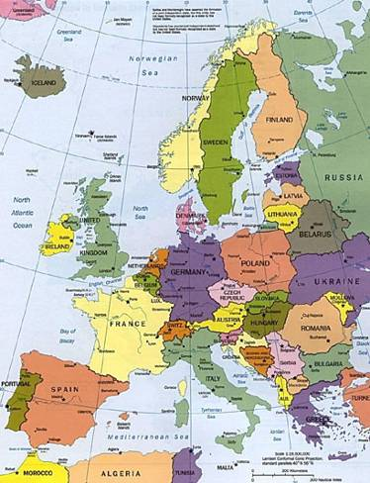
COMENIUS 2012/2014
FINLAND
SWEDEN
AUSTRIA
ITALY
POLAND
HUNGARY
SPAIN

Slide 2
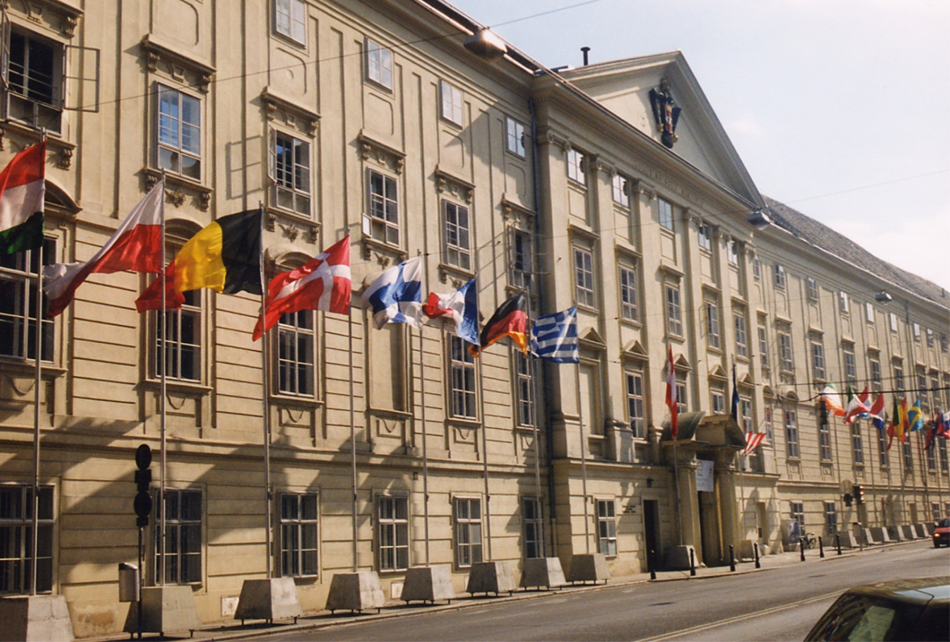
Öffentliches Gymnasium der Stiftung „Theresianische Akademie“ 1746 - 2012
Stiftung
Theresianische Akademie Wien

Slide 3
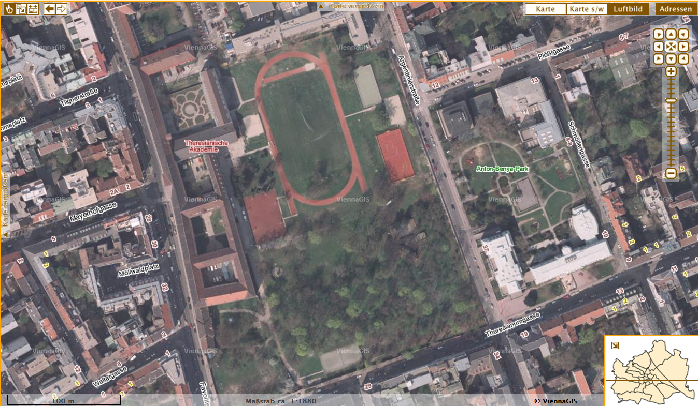

Slide 4
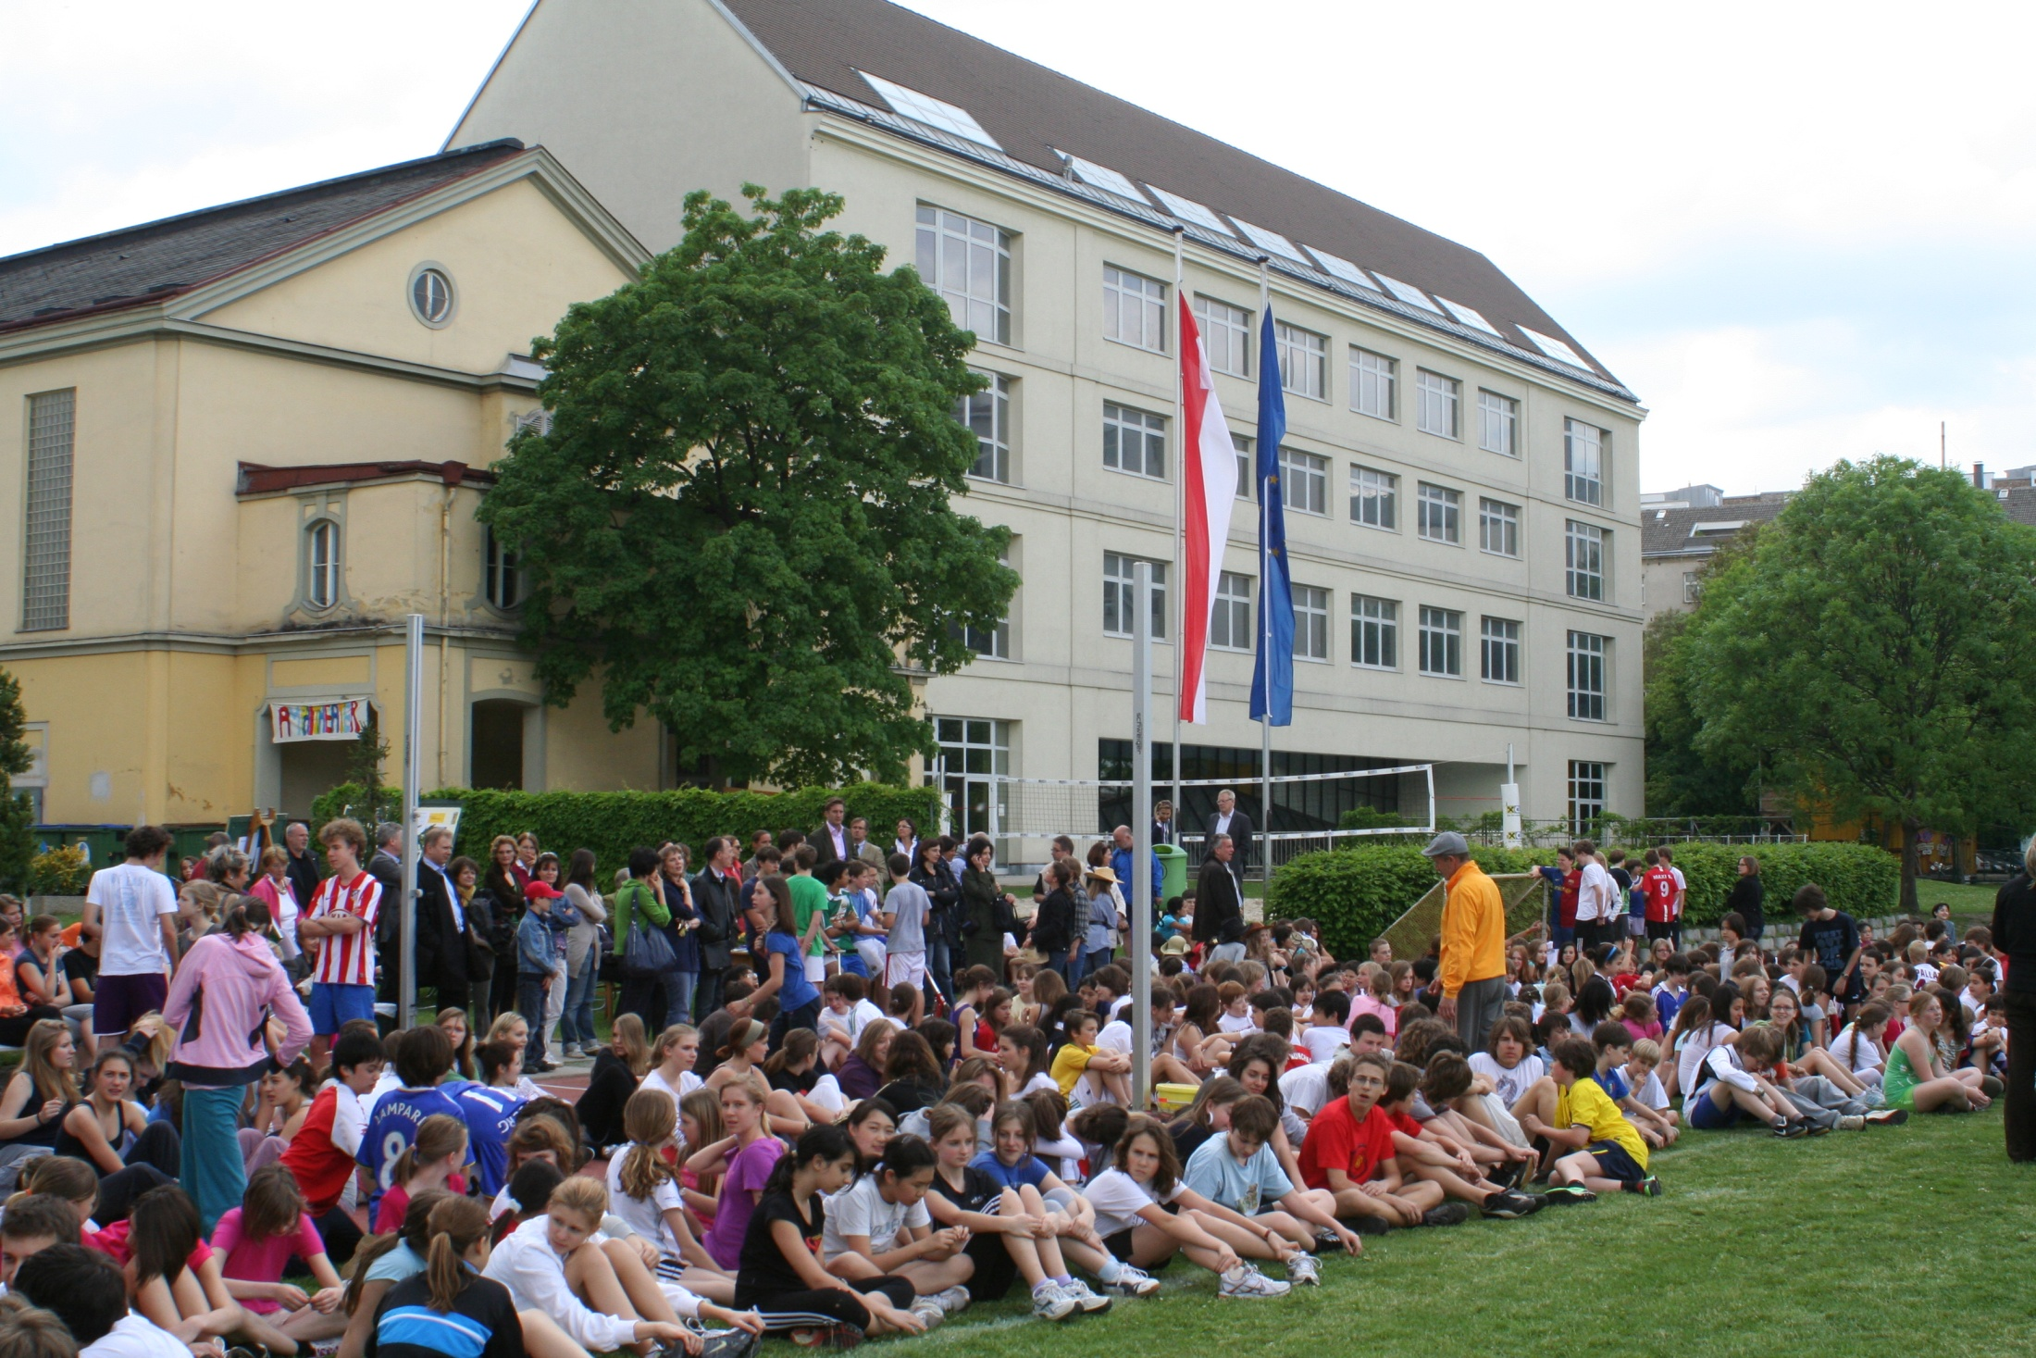
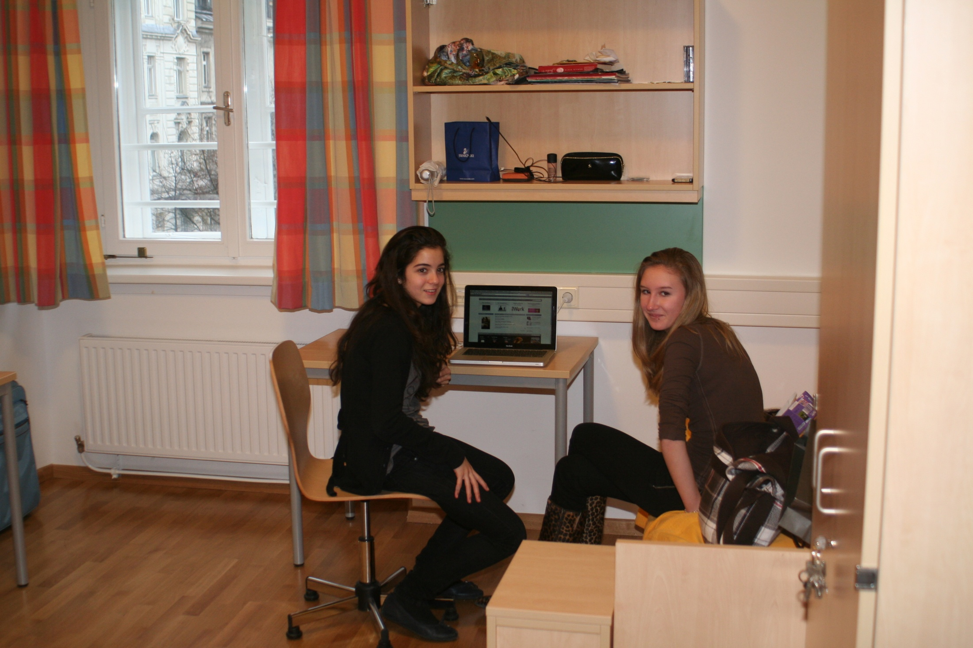
Assets
Location in the middle of the city, good public transport
50.000 m² park, sports facilities, swimming pool, science labs, chapel, etc.
Extracurricular activities (creative, music, games, languages)
Additional qualifications (Cambridge Exams, DELF, EBCL)
270 years of tradition

Slide 5
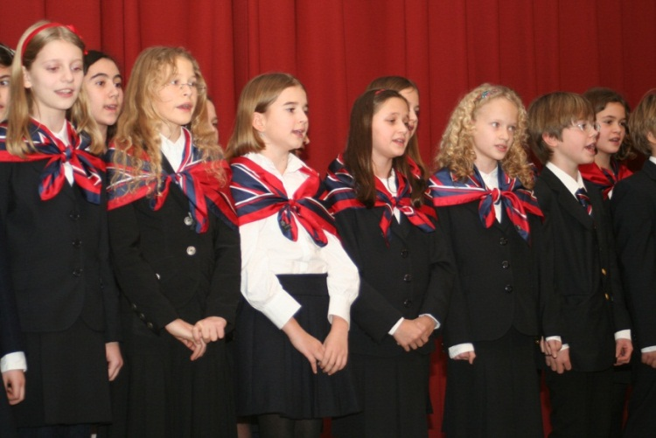
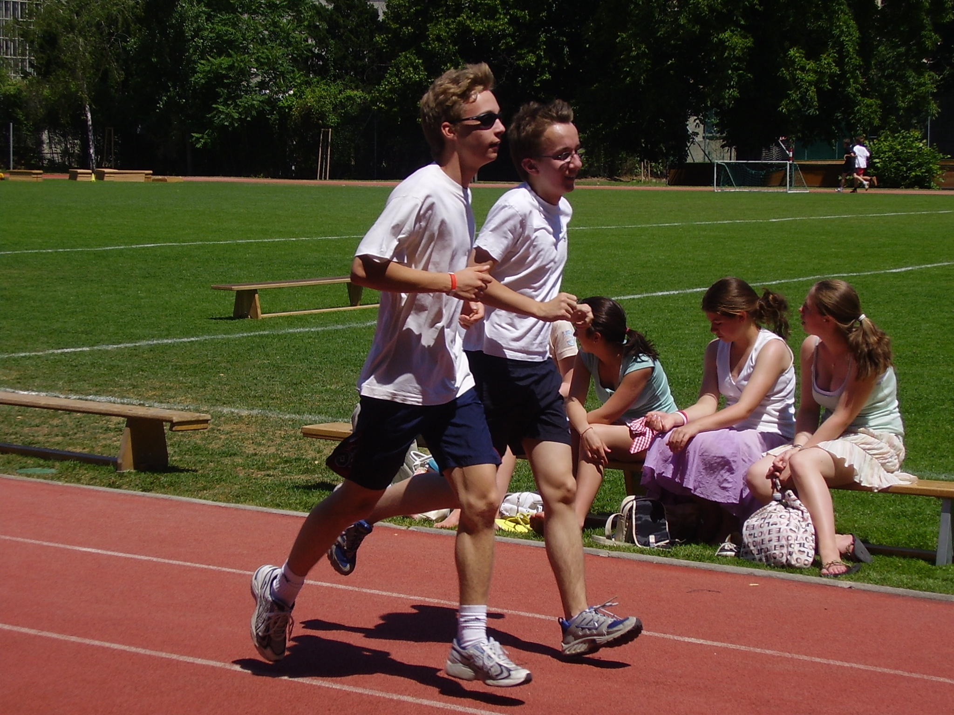
School Focus Secondary Academic School 10 – 18 yrs.
Foreign Languages: 4 mandatory foreign languages: English, French, Latin, Russian
Sport (for a balanced education)
Boarding or day pupils (8 a.m.- 6 p.m.)
International projects
Selection of pupils by interview
830 students, 130 teachers

