Slide 1
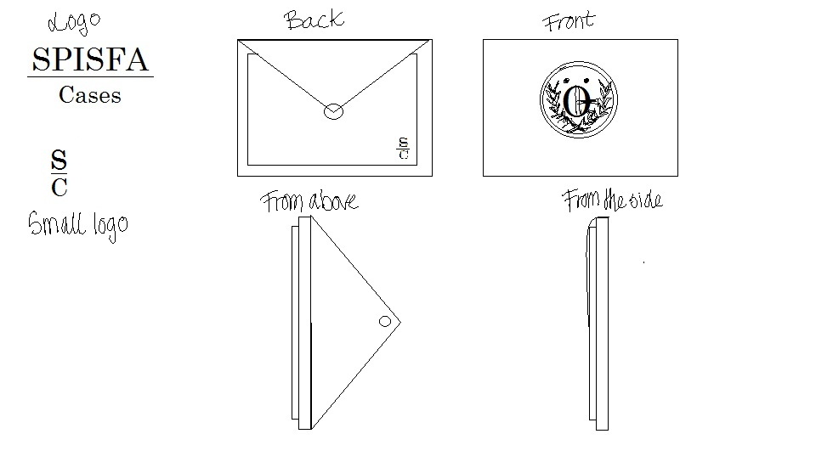
SPISFA Cases

Slide 2
MATERIAL AND PRICE
Material:
Waterproof (outside ➔ eco leather)
Lining (inside)
Magnet (open and close)
Normal price: 19,99€
They are coupons for the first twenty costumers that have a 15% of disccount

Slide 3
MARKETING
Students and teachers can buy it
We can buy it on the school page, and SPISFA cases have a facebook page.
There are flyers like a present in the cases

