Slide 1

From Diversity to Employability
Stockholm meeting
10-13 Feb 2019

Slide 2

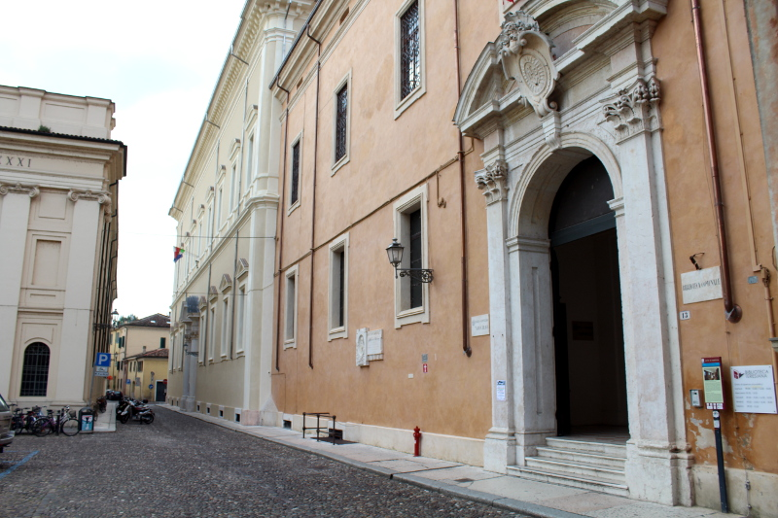
LICEO VIRGILIO - MANTOVA

Slide 3
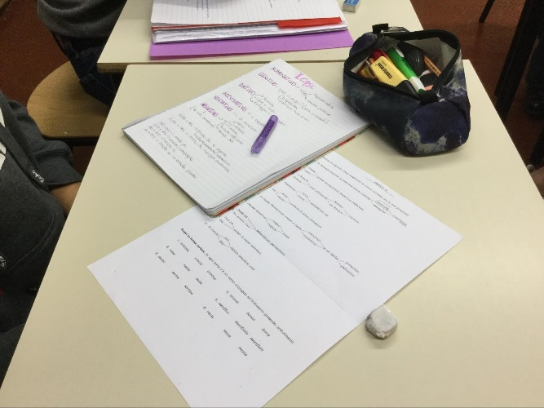
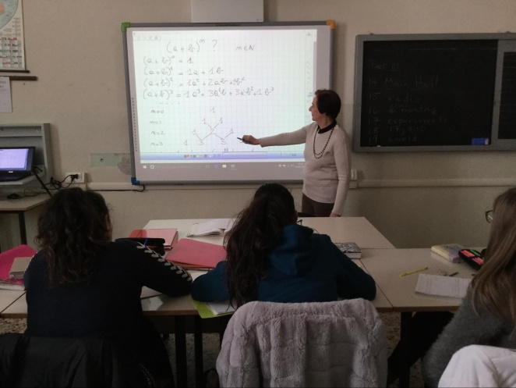
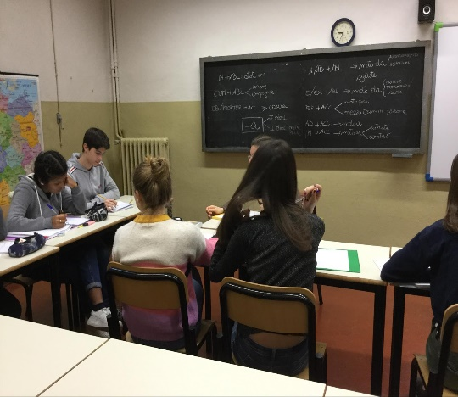
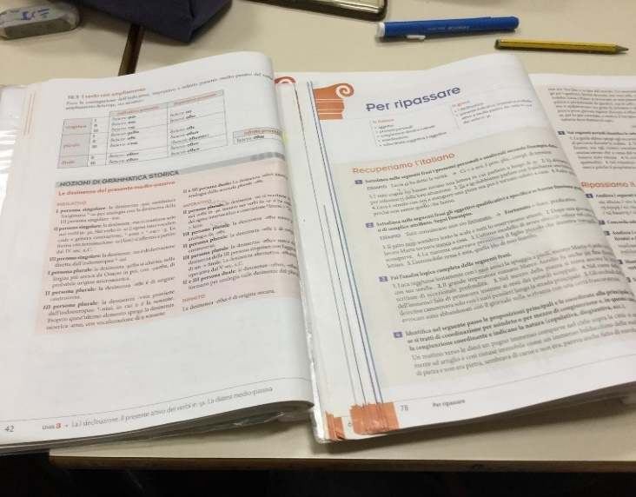
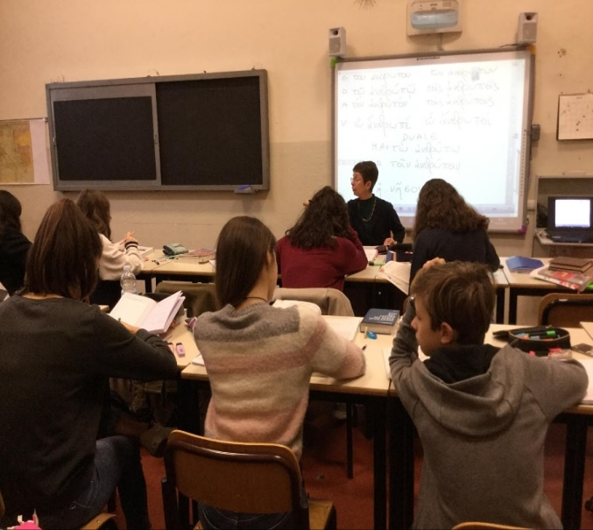
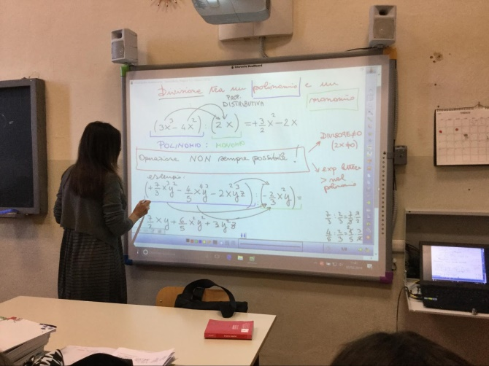
Groups +:
Open class

Slide 4
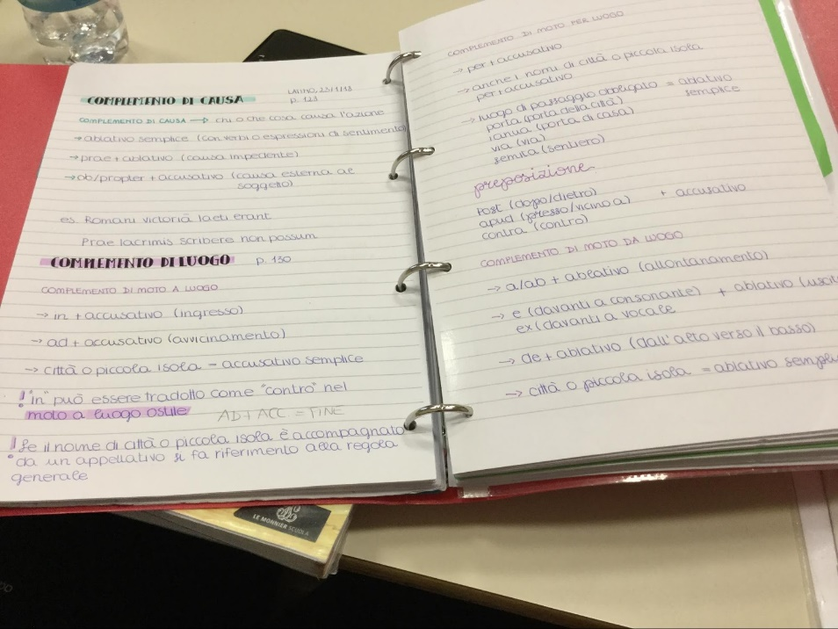
What did we do?
LATIN
Year 1 – 2 ability groups
Main teacher : big group
homework assessment
Extra teacher: small group
remedial work: revision of basic Italian grammar to recognise and describe the way Latin works
Translation practice
TIME: 6 hours

Slide 5
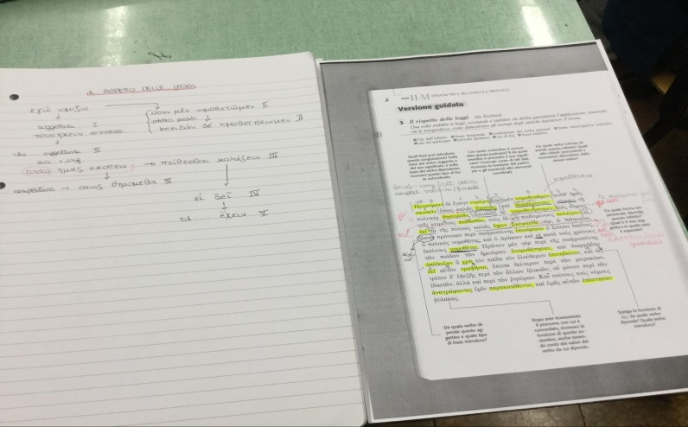
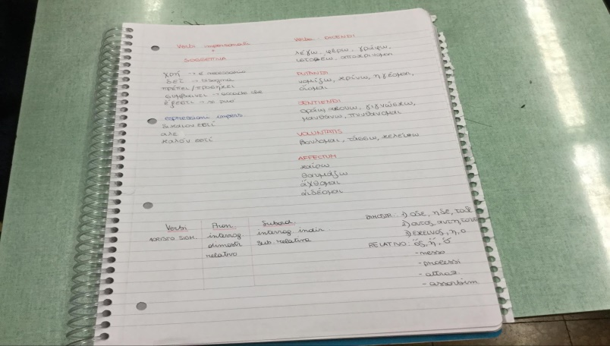
What did we do?
GREEK
Year 3 – 2 groups (class split into two)
Main teacher :
Focus on history of literature : Xenophon of Athens
Extra teacher:
Translation practice of texts: Xenophon of Athens
TIME: 6 hours

Slide 6
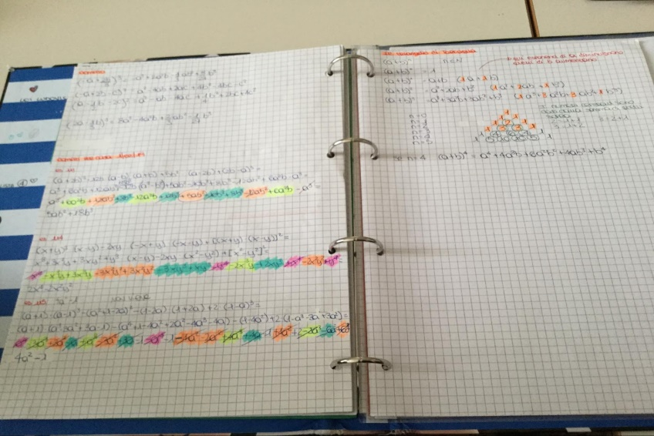
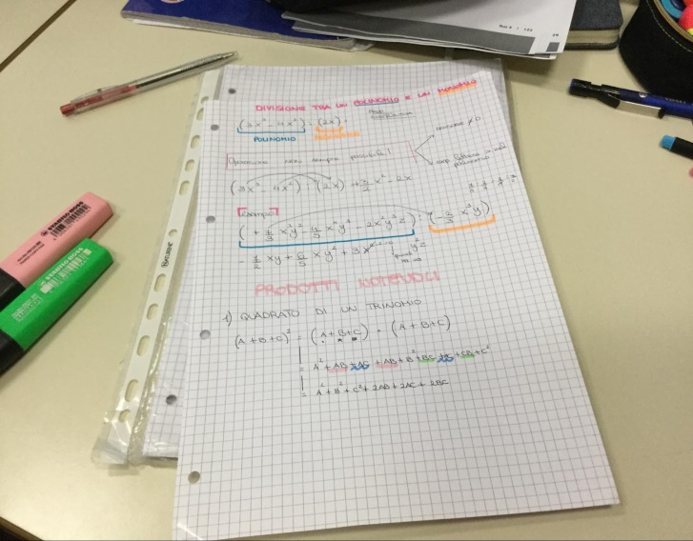
What did we do?
MATHS
Year 1 – 2 groups
Main teacher : high ability group
Tartaglia’s triangle – Oral testing
Extra teacher: low ability group group
Revision of basic concepts (Notable products; dividing a polynomial by a monomial; logics )
Practice
TIME: 3 hours (may be expanded)

Slide 7
What did we learn? Students’ view
What did we like?
Team work
Problem solving
Working with different materials
What went well?
A different perspective: experiencing different teaching styles and methods helps you understand.
Feeling confident in a group of peers
What didn´t we like?
Limited time
Short, isolated experiences

Slide 8
What did we learn? Teachers’ view
What did we like?
Devising different materials
Trying new teaching strategies
What went well?
Working with students with similar learning pace
More active involvement of the students
What didn´t we like?
Limited time
Short, isolated experiences

Slide 9
What would we do differently next time?
Early start
Longer, more structured experiences all the year round
Higher involvement of teachers in different roles
Persuading more teachers to open their classes

