Slide 1
Colégio Campo de Flores Lazarim, Portugal 3rd Erasmus+ Meeting
21st – 24th Oct. 2018
GROUPS+ Project

Slide 2
GROUPS+ Project
Applied in our school since 2013-14
School subjects:
- Maths – 5th - 9th grades
- English – 3rd - 9th grades
(3rd -4th grades, since 2016-17)

Slide 3
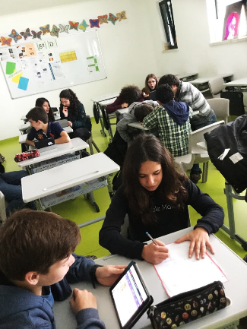
Considering that students...
GROUPS+
have diverse skills and
learning profiles;
have their own working and learning pace;

Slide 4
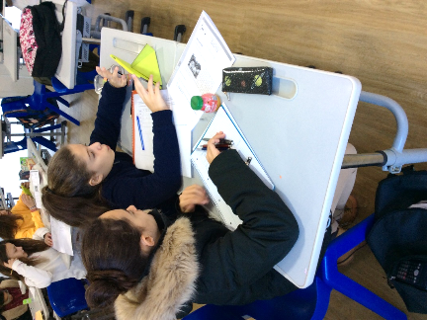
Considering that students...
GROUPS+
GROUPS+
Considering that students...
- have different learning motivations;
learn better when they have higher self-confidence levels;

Slide 5
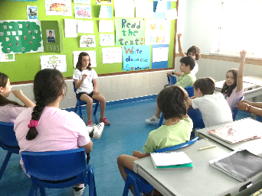
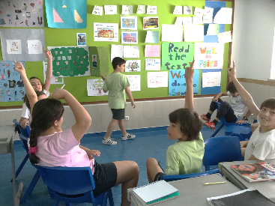
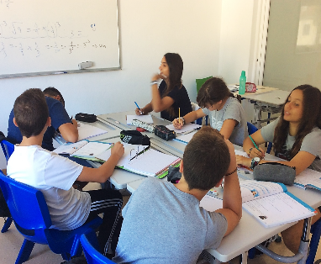
Why GROUPS+ ?
To apply differentiated pedagogy
meeting students’ specific needs
helping students overcome learning obstacles
respecting the students’ learning pace
focusing on students’ skills
developing active learning strategies

Slide 6
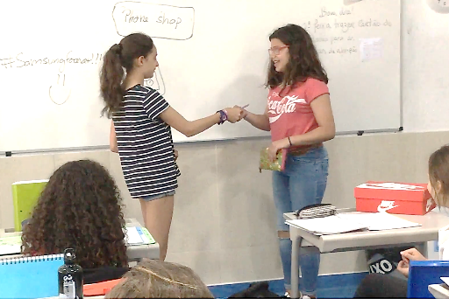
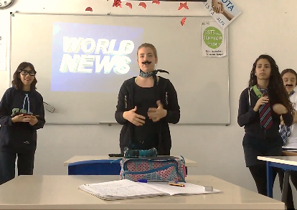
Why GROUPS+ ?
To work in smaller groups
less students in Groups+ than in regular classes
promoting pair and group work
encouraging student/teacher and student/student interaction
developing creative thinking skills

Slide 7
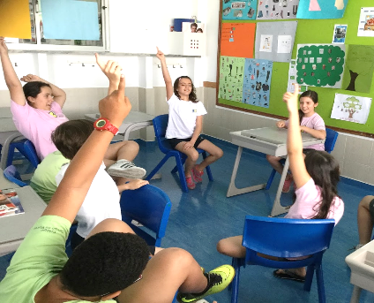
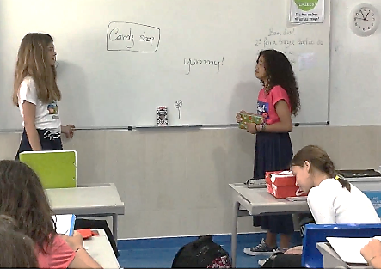
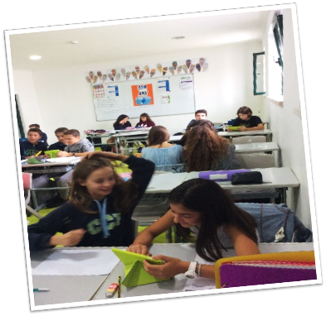
Why GROUPS+ ?
- To promote academic success
increasing students’ motivation
and self-confidence
creating effective learning
developing active citizenship skills

Slide 8
GROUPS+
How does it work?
2 classes make 3 GROUPS+
9th A
9th B
(27 students)
(26 students)
9th A/B
9th A/B
9th A/B
22 students
(Advanced)
21 students
(Intermediate)
10 students
(Structuring)

Slide 9
GROUPS+
How does it work?
3 teachers / one for each group – working simultaneously (3 different classrooms)
All groups follow the same syllabus (established by the Portuguese Ministery of Education, for each grade)
Different teaching strategies / tools / classroom dynamics

Slide 10
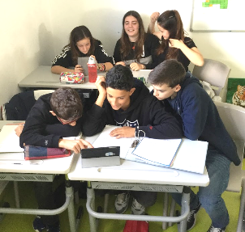
GROUPS+
How does it work?
Different types of assessment instruments to measure the students’ skills (tests, projects, research work…), according to the group’s specific needs
The 3 groups must have at least
1 assessment tool in common, each semester
Collaborative work among teachers is essential

Slide 11
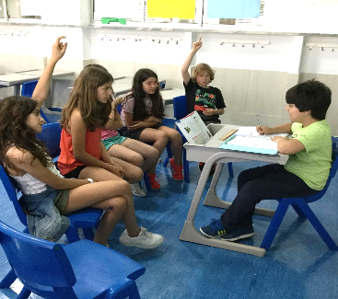
How do teachers determine each student’s Group?
GROUPS+
Features that are taken into account include:
academic achievement
background knowledge structures
commitment to that school subject
motivation level

Slide 12
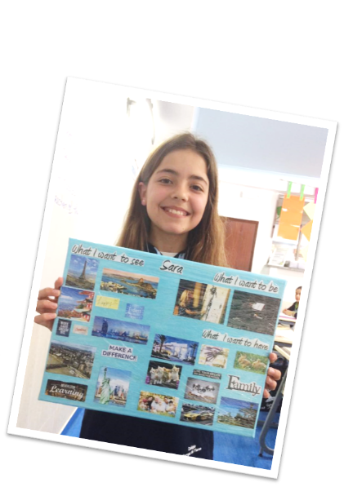
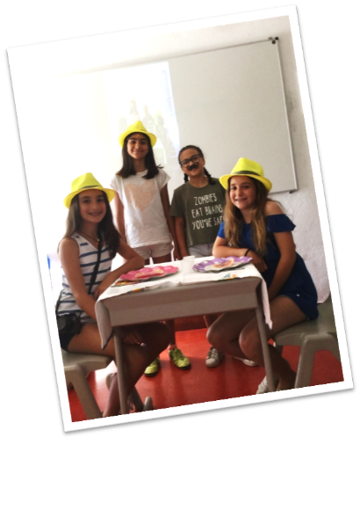
GROUPS+
Defining each group...
Advanced
– students that show a high level of specific and cross-cutting skills (problem-solving, organization, leadership, communication skills...)

Slide 13
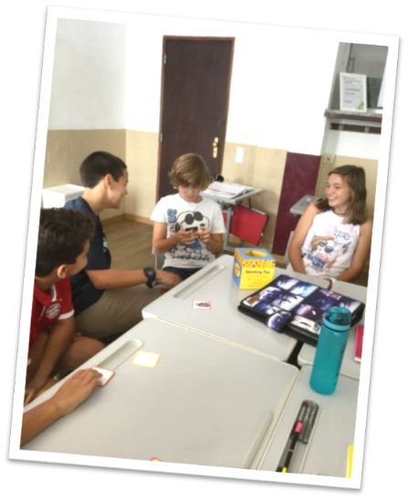
GROUPS+
Defining each group...
Intermediate
– students that show a satisfactory level of specific skills, but still need to develop their full potential and cross-cutting skills

Slide 14
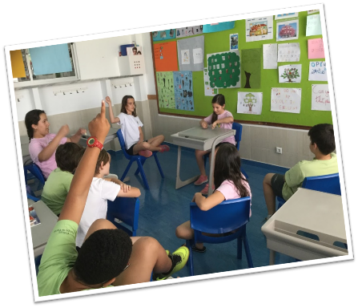
GROUPS+
Defining each group...
Structuring (ideally no more than 12 students)
- students to whom these school subjects are still quite challenging / difficult;
- students who lack background knowledge structures / haven’t developed their potential and cross-cutting skills, yet.

Slide 15
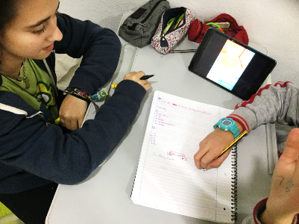
Classroom Dynamics
- Examples -
GROUPS+
English – Reading Activity:
Structuring group
Students read the text out loud / teacher helps with pronunciation
Students go through difficult vocabulary / take notes
True / False + gap-filling exercises + questions + writing answers on the board (...)
Teacher supervises students’ notebooks

Slide 16
Classroom Dynamics
- Examples -
GROUPS+
English – Reading Activity:
Advanced group
Teacher elicits from the students what they know about the subject-matter of the text
Autonomous reading + True/False + synonyms + completing sentences + questions + oral correction
Teacher elicits personal comments (speaking) / debating ideas

Slide 17
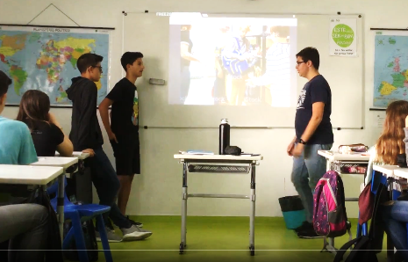
Classroom Dynamics
- Examples -
GROUPS+
English – Reading Activity:
Intermediate group
In this group, according to the students’ specific needs and features, the dynamics are a mix from those presented for Advanced and Structuring groups

Slide 18
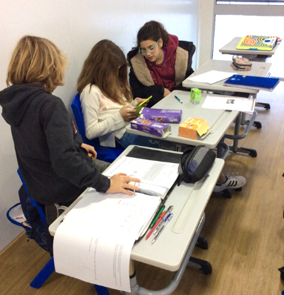
Classroom Dynamics
- Examples -
GROUPS+
Maths
Structuring group
Lessons should always include topics that can be easily related to real life contexts. (For example, calorie index)
Exchanging information in exercise solving.
The teachers focus on maths fundamentals.
Students are engaged in their own learning
process through experimental activities.

Slide 19
Classroom Dynamics
- Examples -
GROUPS+
Maths
Advanced group
- Lessons should also include topics that can be related to real life contexts, but focusing on autonomous learning.
- Students work in smaller groups or pairs and they “play the teacher” (they prepare and present specific topics to teach their classmates).
- Teachers introduce some contents that will be developed in the following school years.

Slide 20
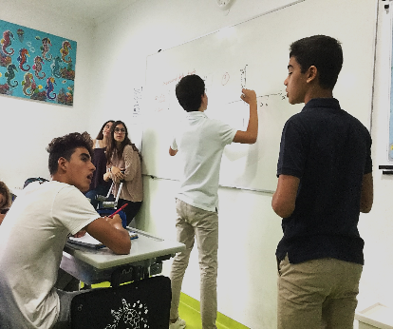
Classroom Dynamics
- Examples -
GROUPS+
Maths
Intermediate group
In this group, according to the students’ specific needs and features, the dynamics are a mix from those presented for Advanced and Structuring groups

Slide 21
Comparing Results: English
9th graders who failed to succeed
11%
4%
Before Groups+
2015
Groups+
2018

Slide 22
Comparing Results: English
9th graders achieving the highest success level
27%
19%
Before Groups+
2015
Groups+
2018

Slide 23
Comparing Results: Maths
9th graders who failed to succeed
16%
4%
Before Groups+
2015
Groups+
2018

Slide 24
Comparing Results: Maths
9th graders achieving the highest success level
31%
26%
Before Groups+
2015
Groups+
2018

Slide 25
What do our students have to say about Groups+ ?
Let’s hear it from them!

Slide 26
Would you consider developing a project of this kind in your schools / subjects? - DISCUSSING -
GROUPS+

Slide 27
Thank You for
Listening!

