Slide 1
From Diversity to Employability

Slide 2
Liceo Virgilio -
Mantova
(Italy)

Slide 3
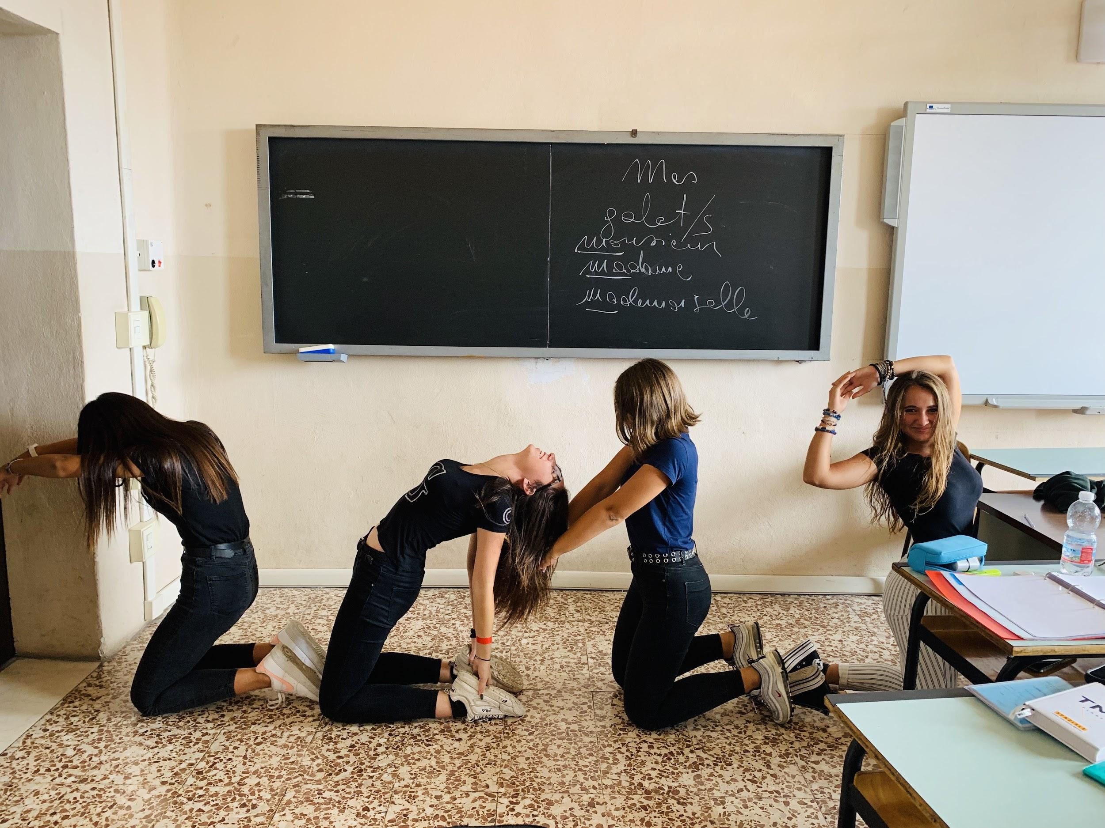
Finnish “School on the move” in Mantova
increase physical activity and decrease sedentary time among students to improve their wellbeing
establish a physically active culture in schools to make learning easier and funnier
2 moments: (1) during lessons, (2) during breaks between lessons
activity-based methods in English classes
experimentation with one class organised by a PE teacher
miming numbers

Slide 4
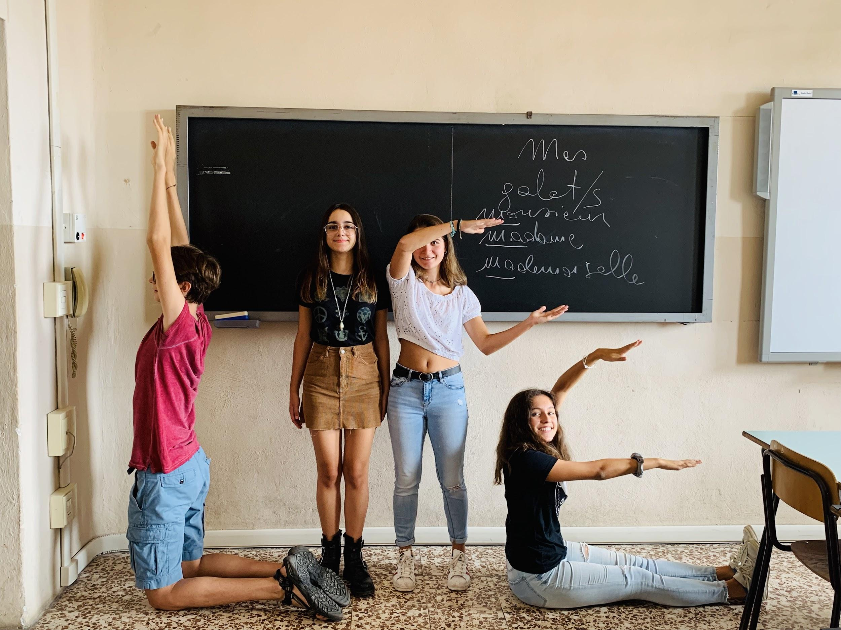
What did we do?
physical activity in English lessons:
running dictation
find someone who (mingling game)
snowball game
miming (actions, movie titles, songs, idioms, numbers, words, etc.)
jump ahead/back
Simon says
miming words

Slide 5
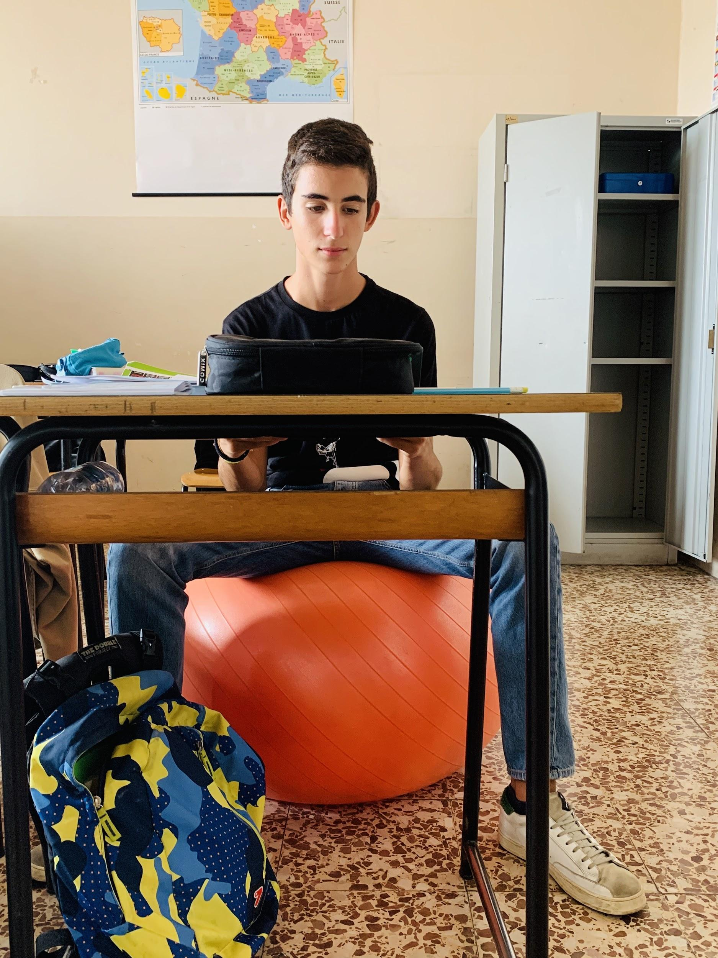
What did we do?
(2) physical activity during breaks:
With the help of their PE teacher, the Ss (and teachers) of one class memorised a fitness routine and performed it between one lesson and the following one, three times a week for some months
Ss sat on gym balls instead of chairs during lessons
sitting on a gym ball

Slide 6
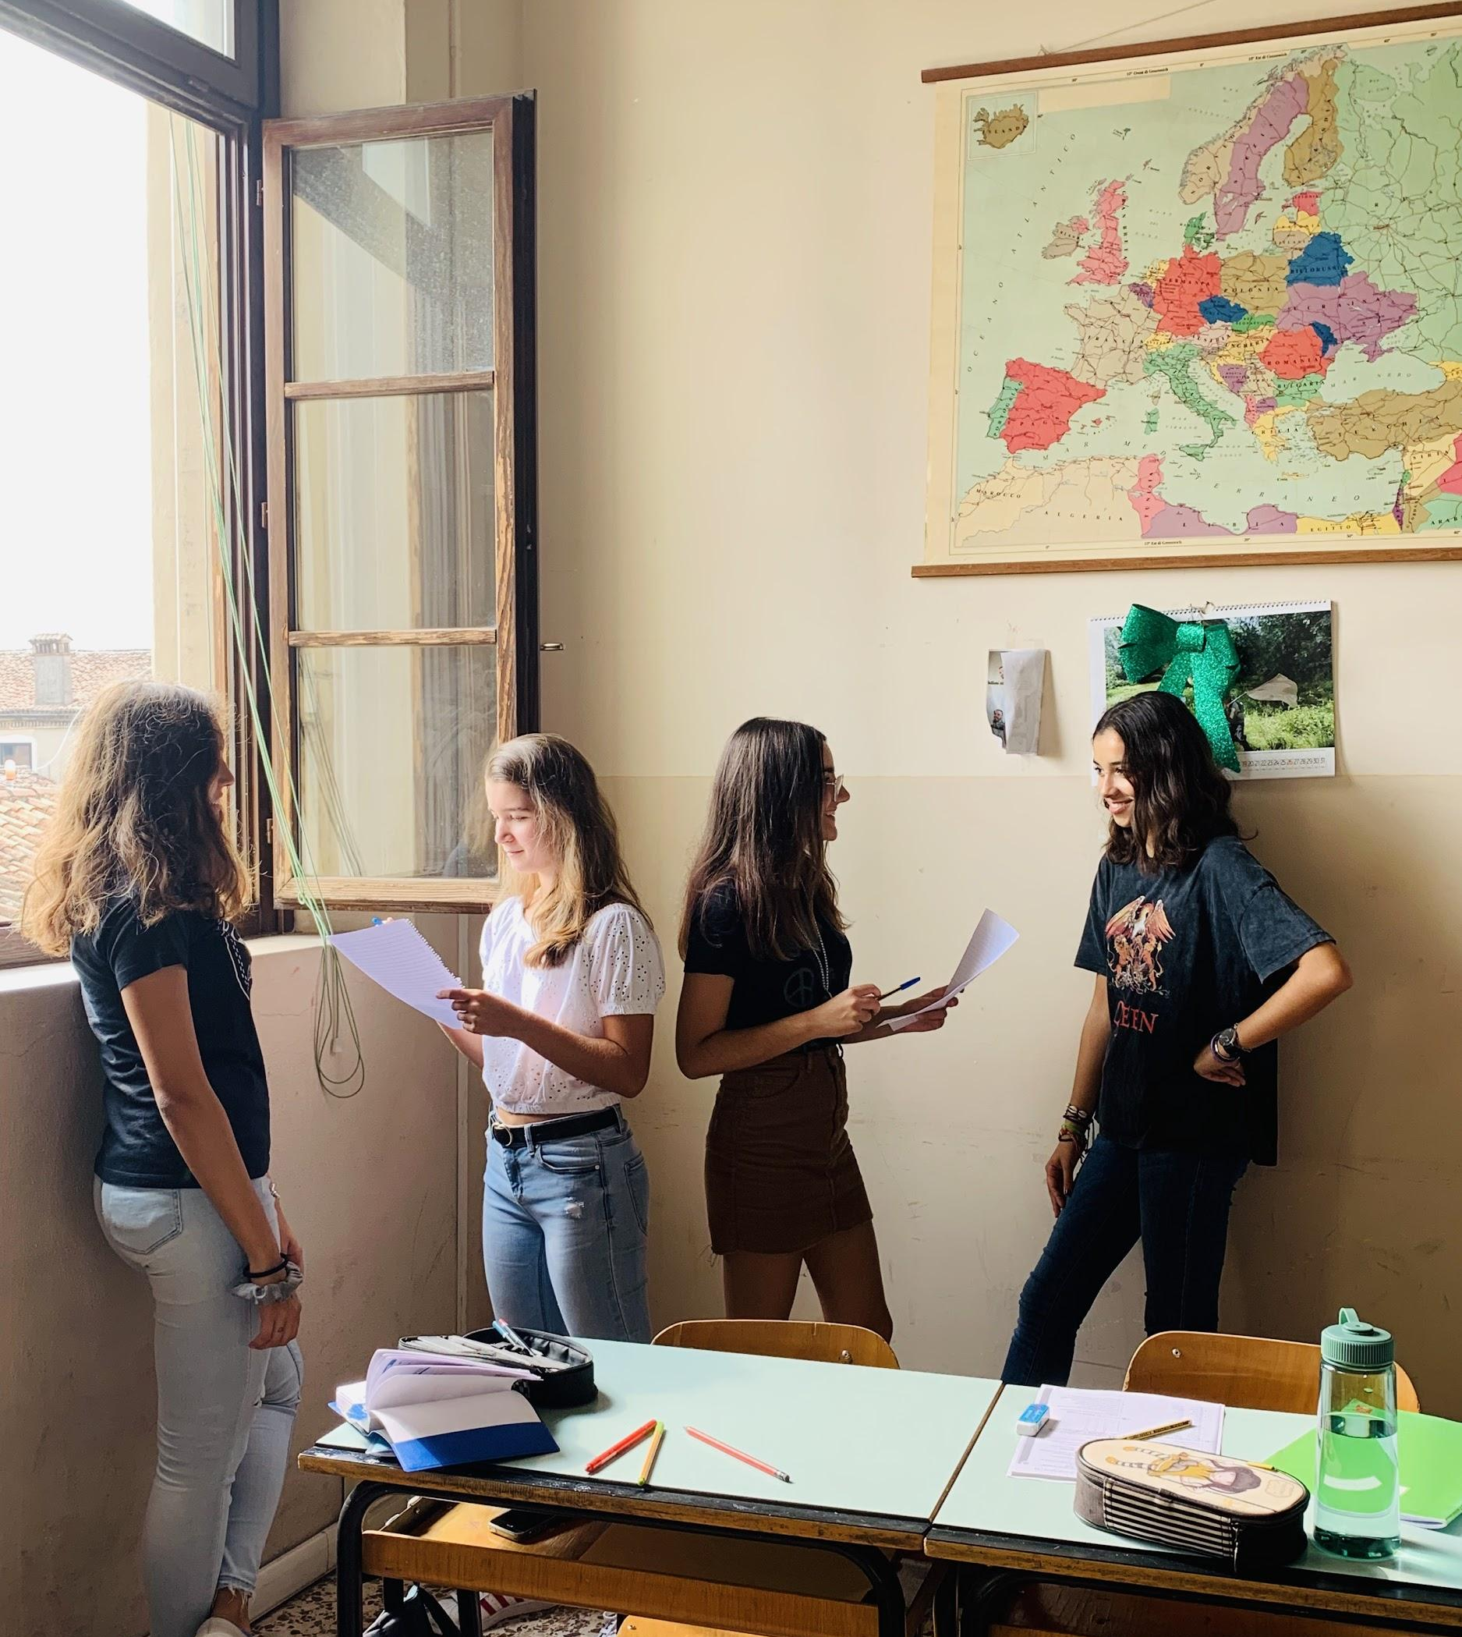
What did we learn?
PROS
more pleasant and funnier school days
more peaceful learning environment
increased concentration and ability to focus
increased attention
fewer disruptions during traditional lessons
better behaviour
interaction and cooperation between Ss and Ts improved the school atmosphere
CONS
Ss confused at first
lazy or shy Ss were reluctant to take part in the activities at first and had to be encouraged
some Ss saw the activities applied to English teaching and learning just as games
some Ss got carried away by the activities
traditional lesson time was reduced sometimes and some teachers protested
mingling games

Slide 7
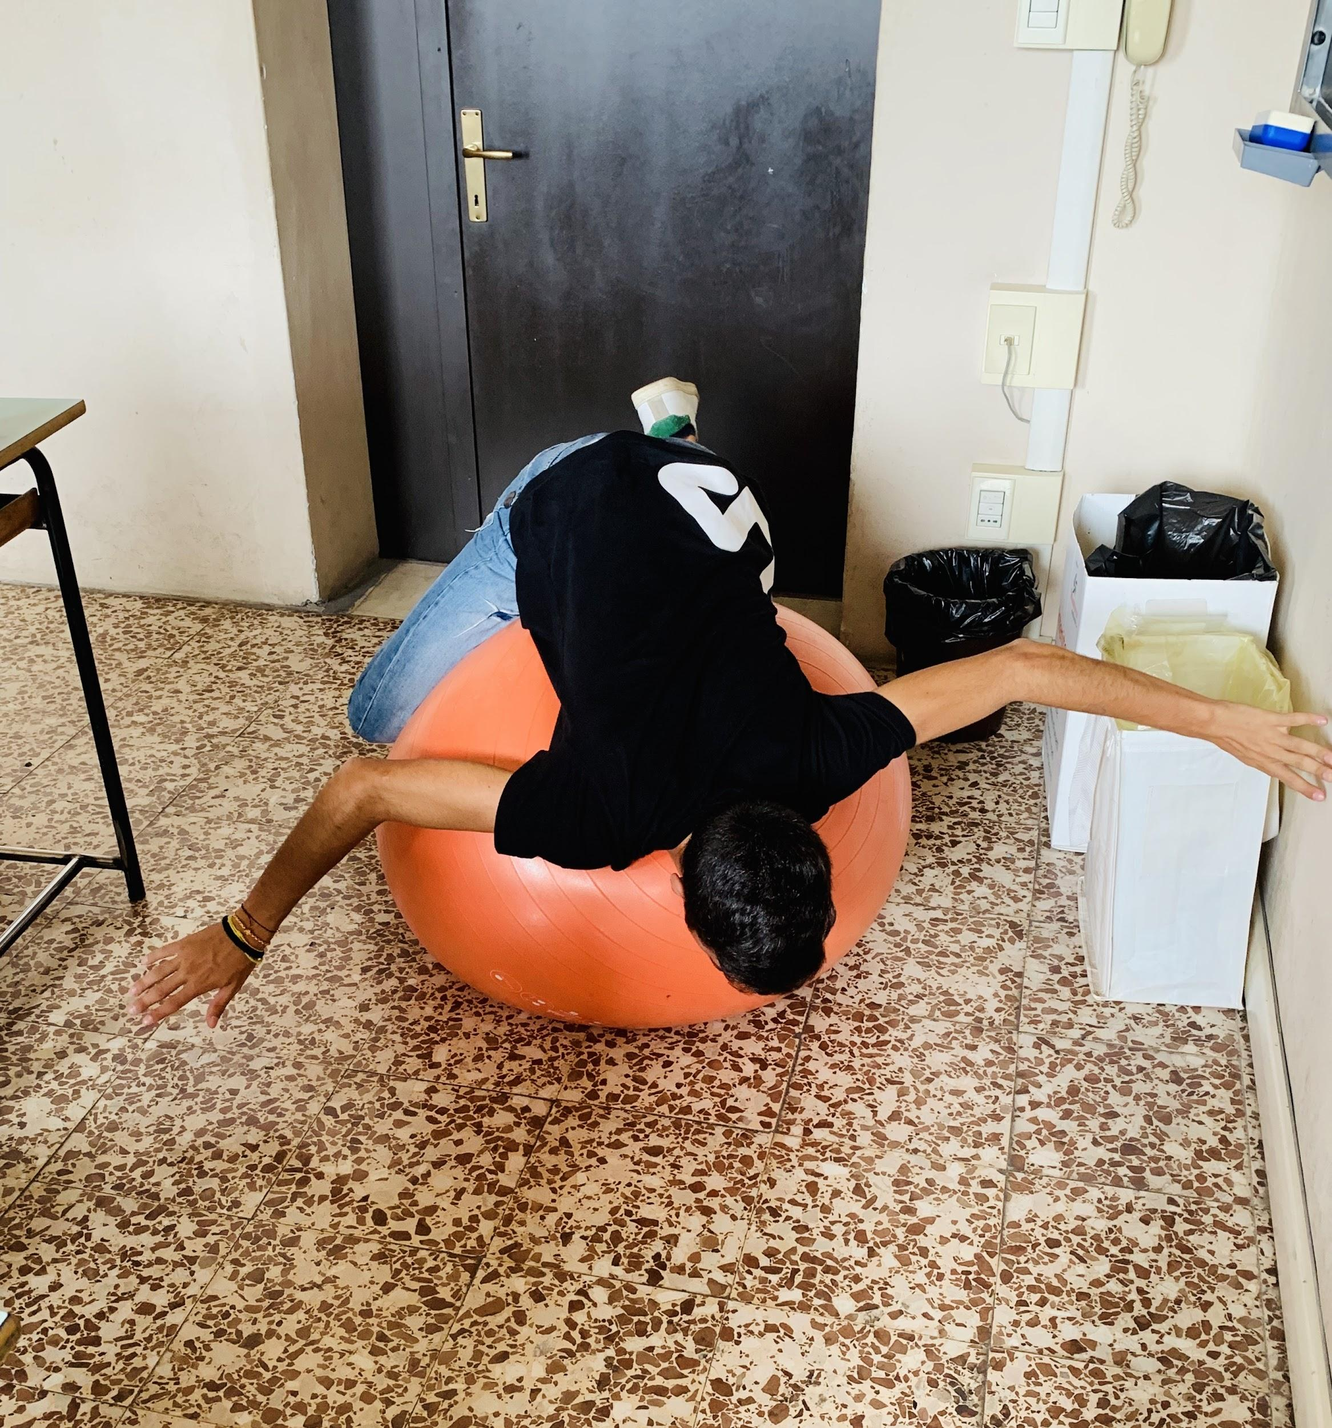
What would we do differently next time?
increase Ss’s participation in planning school activities more actively
involve Ss in decision making about what to do
challenge Ss to come up with fun activities for breaks/recess
encourage Ss to walk along the corridors and go up and down the stairs during recess instead of sitting in their classrooms
promote (more) active school commutes and commutes to hobbies or to friends’ houses
sitting on a gym ball (gone wild)

