Slide 1
Education on the move
Östra Real, Stockholm

Slide 2
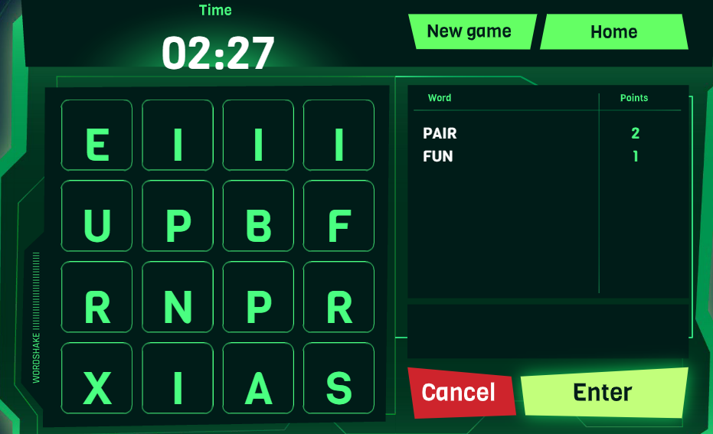
Wordshake

Slide 3
Wordshake
Advantages:
Getting up and moving around
Collective challenge – develops the team spirit
Subject-related

Slide 4
Bingo

Slide 5
Bingo
Advantages:
Getting up and moving around
Students get to know each other
Subject-related

Slide 6
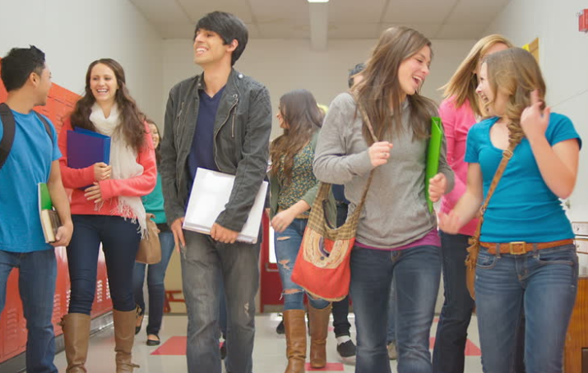
Anti-slumber stroll
Usually done mid-class
Prevents mental fatigue
An opportunity for students
to socialise

