Slide 1
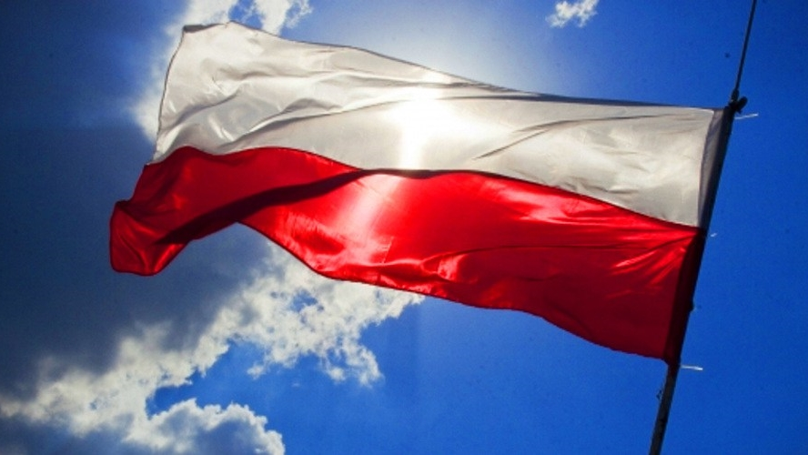


From Diversity to Employability
Gdansk meeting
30th September – 3rd October 2019

Slide 2


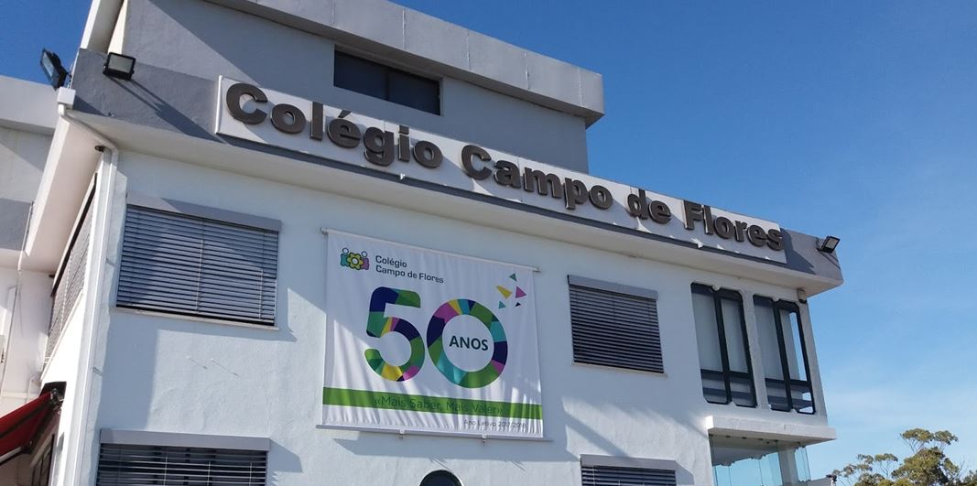
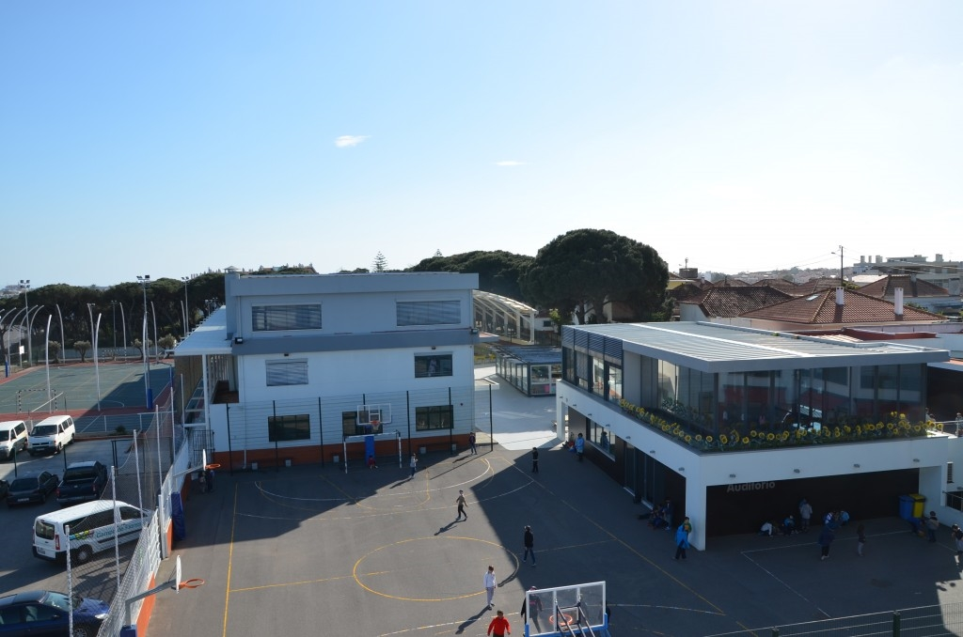


Colégio Campo de Flores, Almada, Portugal

Slide 3
PHENOMENON BASED LEARNING
(Finland)

Slide 4
What did you do?
COLABORATIVE PROJECT
Portuguese Class –7th grade (13 year-old students)
Teachers: Cláudia Barros and Salomé Correia
Subject – Literary work «O Cavaleiro da Dinamarca» by Sophia de Mello Breyner Andresen
Art Class –7th grade (13 year-old students)
Teachers: Flávia Cadete and Lina Vieira
Subject – Graphic diary
Geography Class –7th grade (13 year-old students)
Teacher: Guilherme Franco
Subject – Georeferencing

Slide 5
What did you do?
Portuguese - The students read, in class, with the teacher, the compulsory reading work of the Portuguese subject. The story tells of a journey that begins in Denmark and ends in the Holy Land. Upon return, the main character, the Knight, passes through Genoa, Venice, Florence, Antwerp and returns to Denmark.
Arts - Students attended a lecture about Graphic Diaries.
Geography – Students learnt to geo-reference through applications such as Google Earth and / or Google Maps.

Slide 6
What did you do?
PORTUGUESE
Students were challenged to select two of the cities visited by the knight and to imagine their own virtual trip, writing a Travel Diary/Journey log.
Then they explored websites about cities, their monuments and museums, and their cuisine. They also explored flight booking and hotel websites to learn how to organize future trips.
The last step was writing the text of the diary.

Slide 7
What did you do?
GEOGRAPHY
Students tracked the Knight's route on a map and georeferenced the geographical points of the route they would choose to visit.
ARTS
Students built their diary.
AT HOME
They wrote down the text made in Portuguese class onto the Diary and illustrated it with photographs they collected on the internet, drawings and materials made by them (plane tickets, museum tickets, restaurant menus, etc).

Slide 8
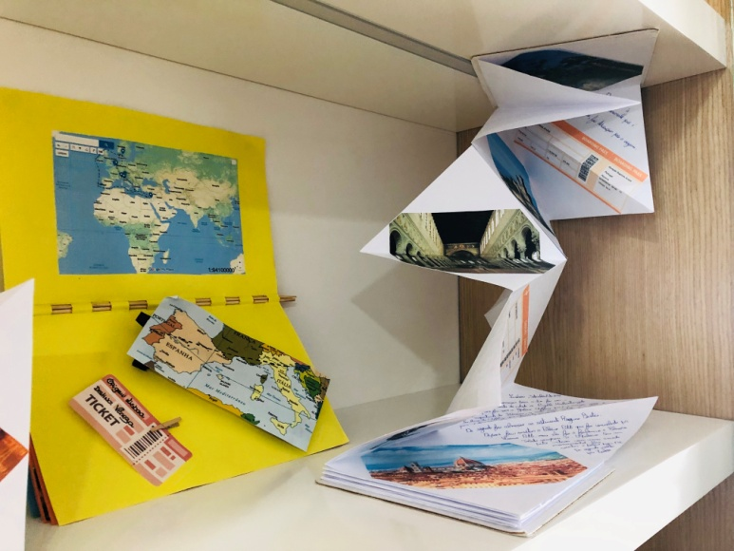
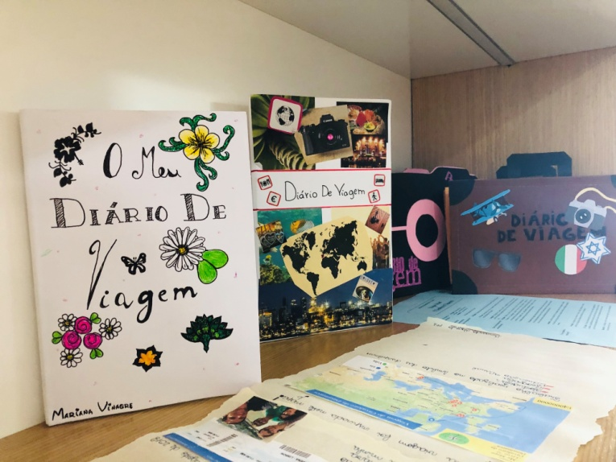
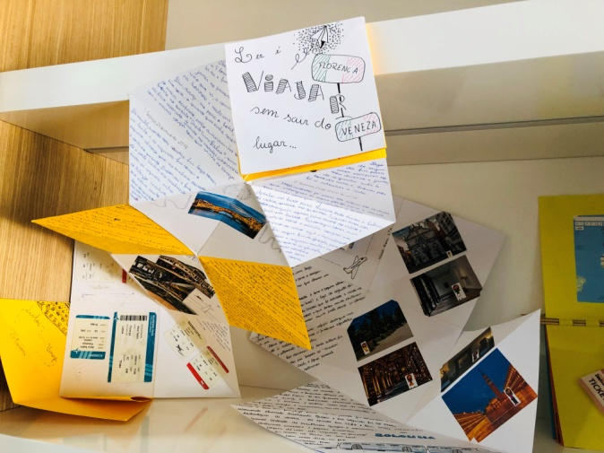
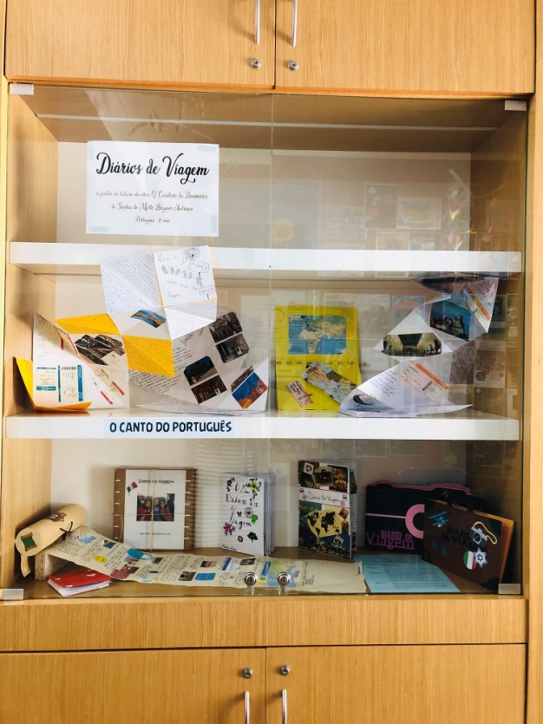
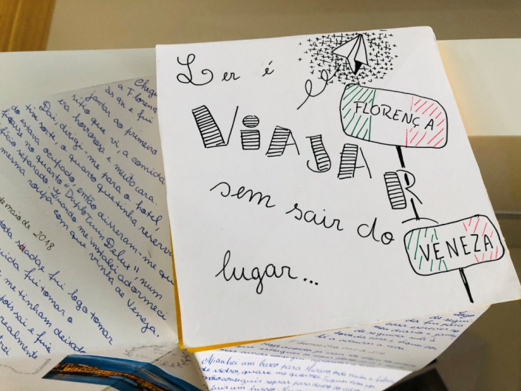
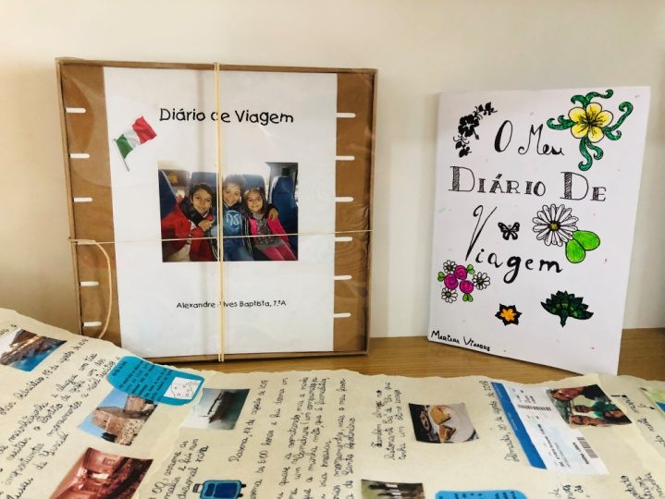
What did you do?

Slide 9
What did you learn?
 Students were very excited to be able to apply knowledge learnt in class;
 Students' creativity may surprise us, so we should give them space and not always format or limit the assessment or tasks to be done.

Slide 10
What did you like?
 The enthusiasm shown by the students was truly appreciated;
 Their commitment to the construction of the travel diary is worthy of acknowledgement;
 The creativity of some diaries matched the teachers' initial challenge and expectations.

Slide 11
What went well?
 Students’ commitment and motivation;
 Students’ creativity (diary model, plane tickets, museum tickets, etc).

Slide 12

What kind of challenges did you come across?

The short time we had to develop the project, given the extension of the subjects’ program.
 The immaturity of the students that impaired their abstract thinking, causing them to have a hard time writing a journal of activities that never happened in reality. They tended to write narrative text in the past, not a diary in the present.

Slide 13
What didn’t you like?
This project, although collaborative, was not based on a common phenomenon or theme as presented to us in Finland.
Due to the limited time left until the end of the school year, it was no longer possible to develop a new project similar to the Finnish one, so we present our collaborative project experience (one amongst many developed by several subjects and in different grades).

Slide 14

What would you do differently next time?
We would start from a phenomenon, from a current problem and involve students and their families in the suggestion and choice of themes, just like in Finland!

Slide 15
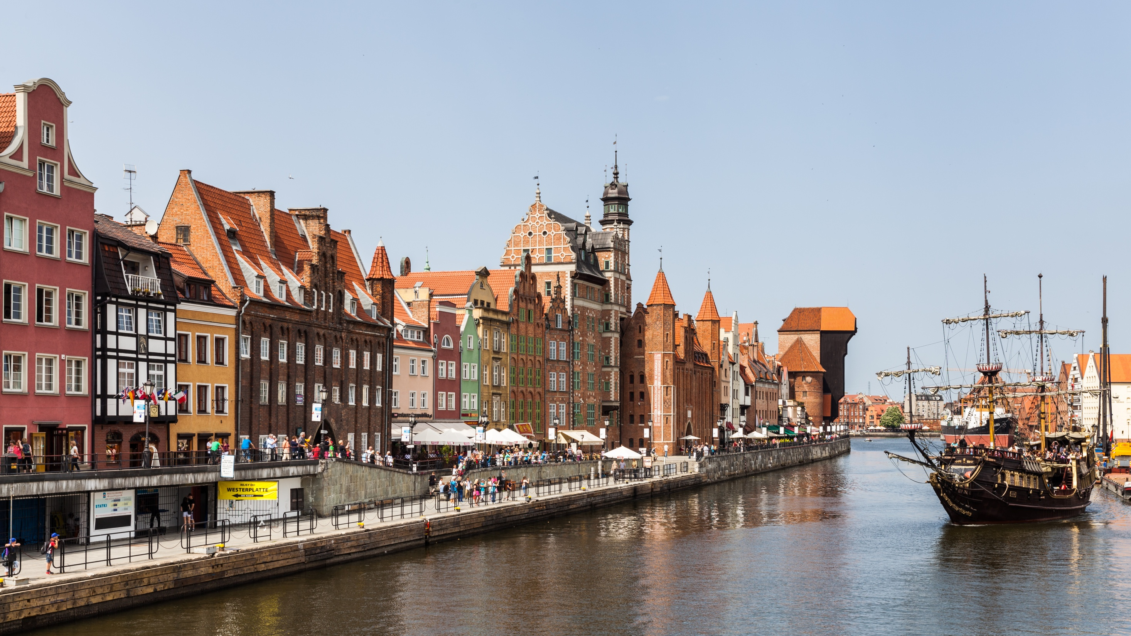

From diversity to employability
- new trends and methods in learning
Presented by Cláudia Barros (PORTUGAL)

