Slide 1
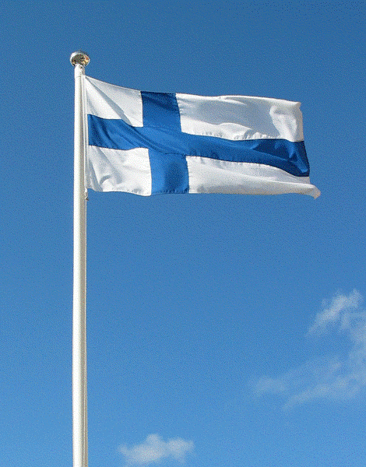


From Diversity to Employability
Kerava meeting
24th – 30th April 2019

Slide 2

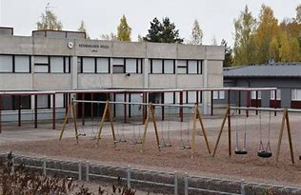
Keravanjoen koulu, Lapila

Slide 3
Strategies for digital learning

Slide 4
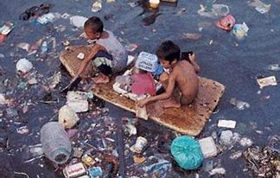
What did you do?
*We had a picture
*Students had to think and search information
-what has happened
-why that has happened
-what is the reason for that
-where has that happened
-is there any ideas how we can stop this
-In next lesson we processed/went through students answer and continue

Slide 5
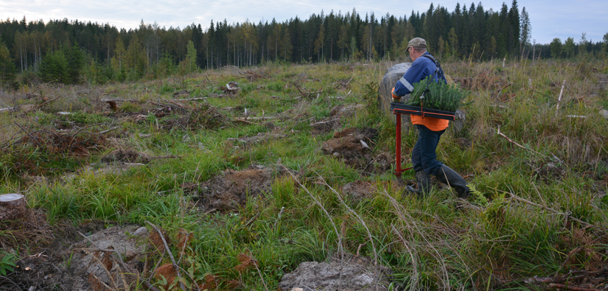
What did you do?
*We had a picture
*Students had to think
and search information
- what is happening in the picture?
- what has happened before?
- utilization of forrest
- In next lesson we processed/went through students answer
and continue

Slide 6
What did you learn?
*For some students this is good way to think through different subjects and find new aspects
*For some students this was too difficult
* Students learned something about causation

Slide 7
What did you like?
*Students took part pretty well (some)
*We could continue on and on to so many things like: why there is poor people, pollution in different continents, how can we help people
* Also forrest-picture got students talk about broad range of topics

Slide 8
What went well?
*In groups there were students who like this kind of method
*Some students found out very many things about sustainable use of forrest and plastics

Slide 9
What kind of challenges did you come across?
*too little time
*conversation continues on and on to different levels (this is also a good thing but requires more time☺)

Slide 10
What didn’t you like?
* We liked it ☺

Slide 11
What would you do differently next time?
*would have more time to process
* find better picture

Slide 12
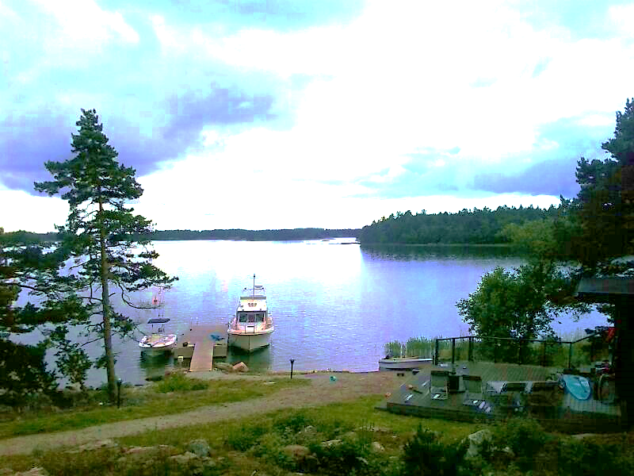
From diversity to employability
- new trends and methods in learning
Presented by Finland Miia and Heidi

