Slide 1
Liceo Classico e Linguistico “Virgilio”
Mantova - Italy

Slide 2
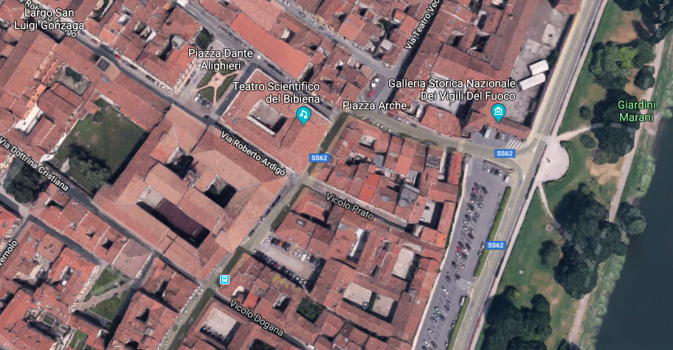
Location

Slide 3
Schools in location
Secondary Academic School: ages 14-18
Liceo classico : 287 pupils
Liceo Linguistico : 543 pupils
72 teachers

Slide 4
State School Status
Secondary Academic School: teachers provided and paid by state
Optional School fee : € 80- p.year

Slide 5
School in project
LICEO CLASSICO:
Traditional curriculum
Extra maths
Extra English
LICEO LINGUISTICO:
Traditional curriculum (3 Foreign Languages)
Esabac (Double Degree – Italian and French)

Slide 6
School Focus
Secondary Academic School
CLASSICO: Greek - Latin - English
LINGUISTICO: 3 mandatory Foreign Languages
International relations
Permanent class groups: class groups stay together in all lessons

Slide 7
Assets and Offers
Free time sports
Leisure activities (Photo-Lab, Drama classes, Theatre nights, Music and cinema classes)
Cambridge First Certificate Exam (year 4/5)
Delf B2 (French Exam, year 4/5)
Dele B2 (Spanish Exam, year 4/5)
Goethe Zertifikat (German Exam, year 4/5)
HSK - Chinese Proficiency Test
ECDL - IT European Certificate

Slide 8
Travel Programs
Language exchanges / weeks (Salamanca, Nevers)
ONU Youth Ambassadors in New York
Individual Exchanges (Paderborn – Transalp, etc)
Erasmus project
Summer courses abroad (UK, Spain, France, Germany)
Cultural and educational trips to main European cities (Berlin, Rome, Vienna, Paris, Barcelona, Madrid, etc.)

Slide 9
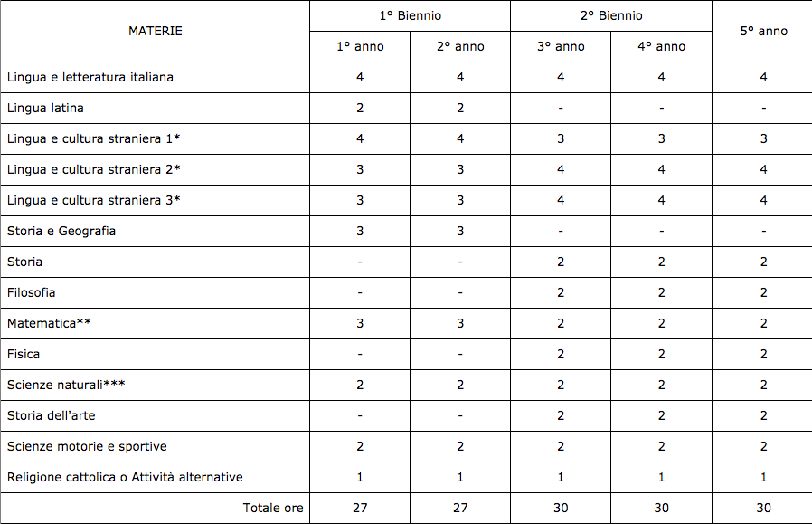
Lesson Grid - Liceo Linguistico

Slide 10
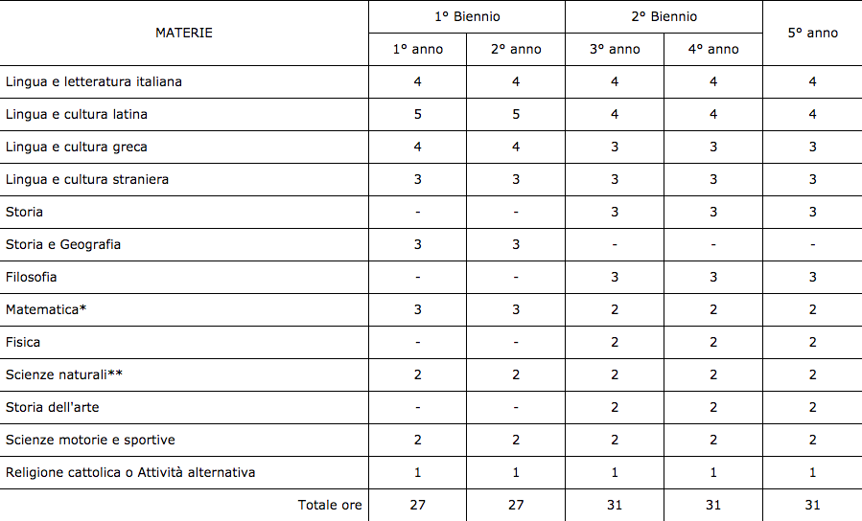
Lesson Grid - Liceo Classico

Slide 11
Typical teacher schedule
 | Monday | Tuesday | Wednesday | Thursday | Friday | Saturday
08-09 |  |  |  | 2BL | 5BL | 1BL
09-10 |  |  | 2BL | 1BL | 1BL
10-10.50 |  | 4AR |  | Available for Substitution absent teachers | 3AL | 3AL
11.05-12 |  | Parents’ visits | 1BL |  | 2BL | 2BL
12-13 |  | 3AL | 5BL |  | 4AR | 5BL
13-14 |  |  | 4AR

Slide 12
Typical teacher schedule
Full teaching load: 18 lessons
1 hour for parents‘ visits
hours for substitution for absent teachers (paid)
extra hours for remedial work (paid)
teachers must have master´s degree in 1 subject

Slide 13
Typical class schedule (first year / ling.)
 | Monday | Tuesday | Wednesday | Thursday | Friday | Saturday
08-09 | German | Latin | Latin | French | Italian | English
09-10 | Italian | Italian | Religion | English | English | Biology
10-10.50 | Italian | Italian | Italian | PE | Maths | Maths
11.05-12 | French | Maths | English | PE | German | French
12-13 |  | German | Biology |  | Italian

Slide 14
Comenius History
1998 – 2000, “A Single European Currency in a Multicultural Europe”
2000 – 2003, “Caleidoscope - Rencontre Européenne de Lyceens”
2003 – 2006, Octopus: “European School Quality in International Dimensions”
2006 – 2009, “European Citizenship”
2009 – 2011, “European Studies School Network”
2011 – 2015, “Young European Entrepreneurs of the Future”

Slide 15
www.liceovirgiliomantova.gov.it
Via Ardigò 13
46100 Mantova
Tel. +39 0376 320366

