Slide 1
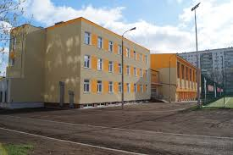
ZESPÓŁ SZKÓŁ SPORTOWYCH
I OGÓLNOKSZTAŁCĄCYCH
www.zssio.com.pl

Slide 2
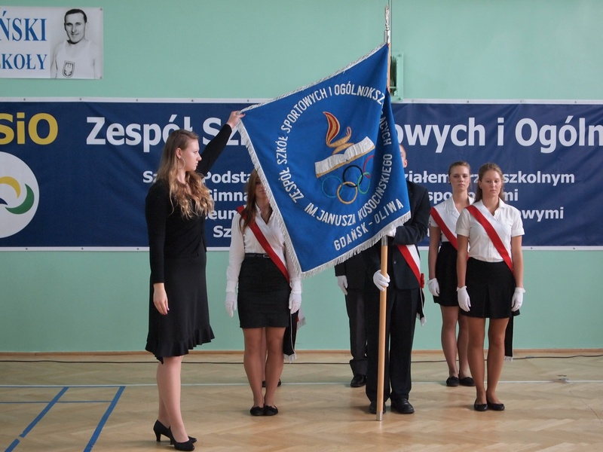
Our traditions

Slide 3
Olimpic Games

Slide 4
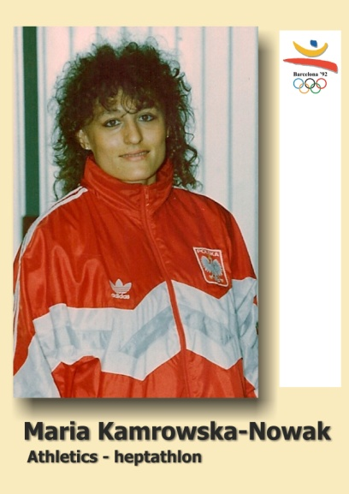
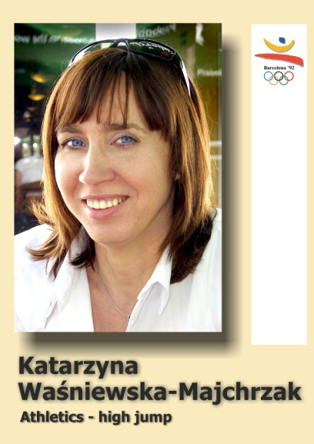
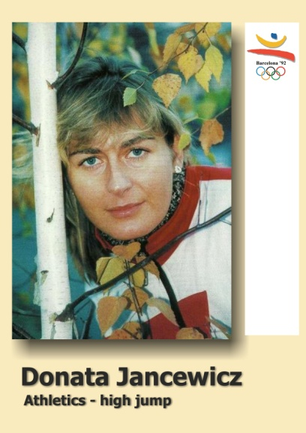
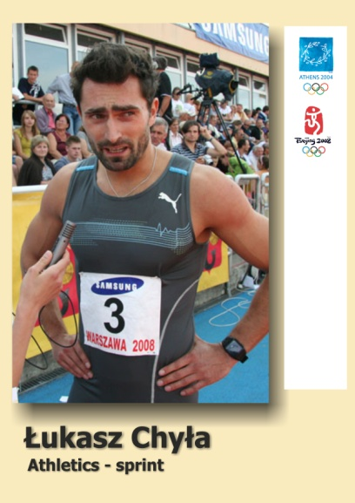
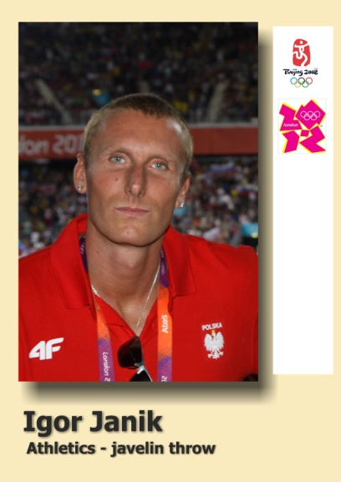
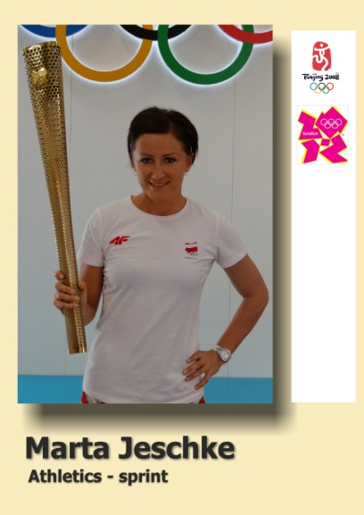
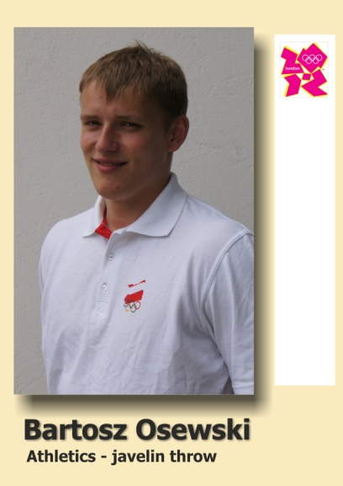
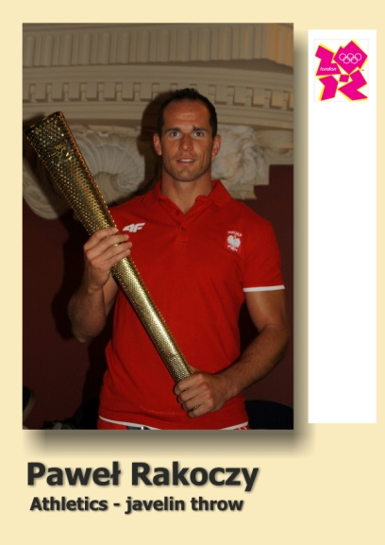
Our Champions – track and field

Slide 5
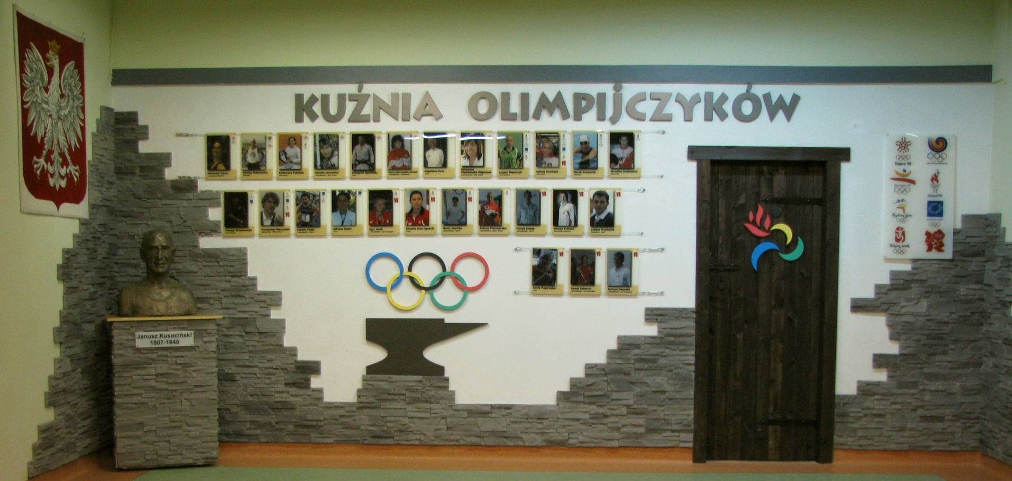
Olympian’s corner

Slide 6
School divisions
Kids aged:
Pre-school education 5/6
Primary school no. 75 7-12
Lower – secondary school
(Gymnasium no. 15) 13-16
XII Secondary school 16-19

Slide 7
Numbers
Number of students – 750 including: - 350 in Pre- and Primary school - 140 in Lower-secondary school (Gymnasium) - 215 in Secondary school - 52 in Sport School
Number of teachers - 170 including: - 90 subject teachers - 60 trainers

Slide 8
Students’ Timetable – Sport Masters’ class
 | time | Monday | Tuesday | Wednesday | Thursday | Friday | Saturday
1 | 7.20-8.05
2. | 8.10-8.55
3. | 9.05-9.50 | Maths |  |  |  | Biology
4. | 10.00-10.45 | Polish | History | Polish |  | Religion | training
5. | 10.55-11.40 | Russian | Geography | Polish | Polish | Russian | training
6. | 11.50-12.35 | Meeting with form teacher | Religion | Maths | Biology | Maths | training
7. | 12.50-13.35 | English | Social Science | Russian | History | Biology
8. | 13.50-14.35 | English | Polish | Russian | English | English
9. | 14.50-15.35 | training | training | training | training | training
10. | 15.45-16.30 | training | training | training | training | training
11. | 16.35-17.20 | training | training | training | training | training
12. | 17.25-18.10 |  |  | training

Slide 9
English teacher’s timetable
 | Monday | Tuesday | Wednesday | Thursday | Friday
1. | - | III D | - | - | -
2. | - | III E | - | III D | III F
3. | individual lesson (one student) | I A | II E | III E | III E
4. | II E |  | III F | II E | III D
5. | individual lesson |  | III E | individual lesson | I A
6. | III F |  | I A | I A
7. | III E |  | individual lesson

Slide 10
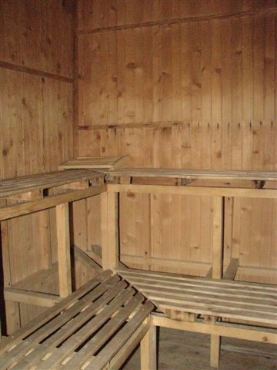
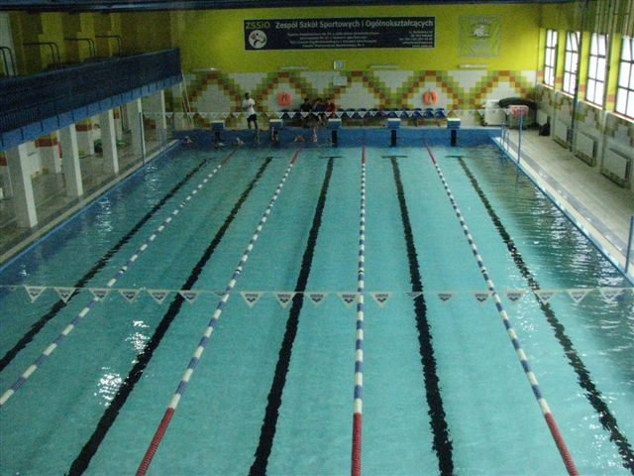
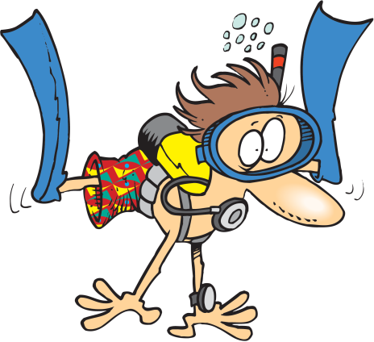
School facilities

Slide 11
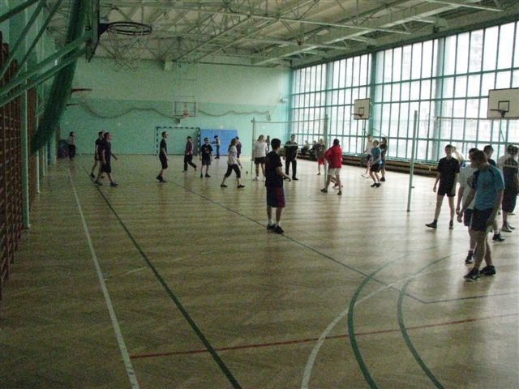
School Sport hall

Slide 12
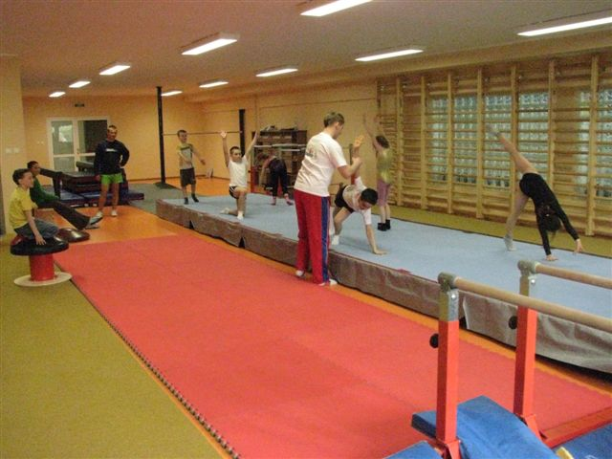
Gymnastics sport hall

Slide 13
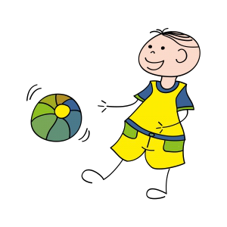
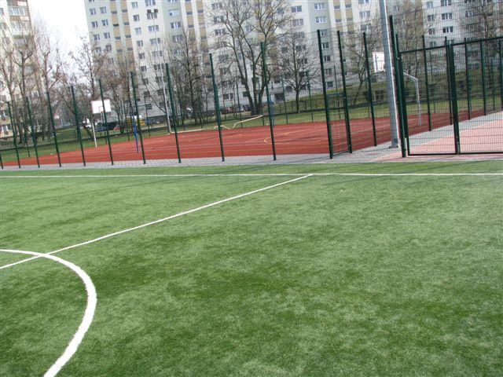
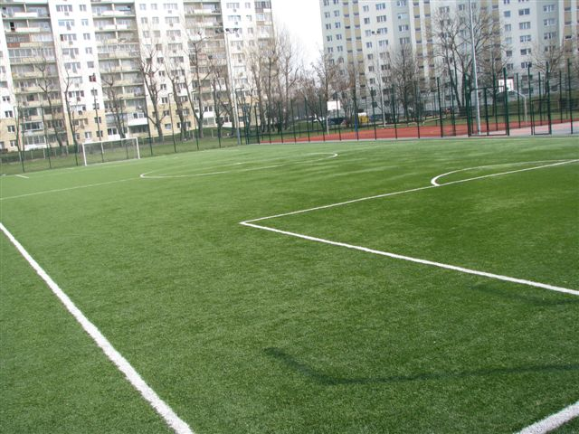
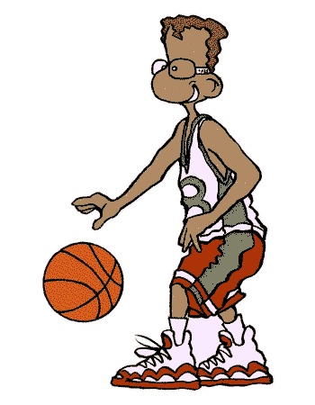
School field ORLIK

Slide 14
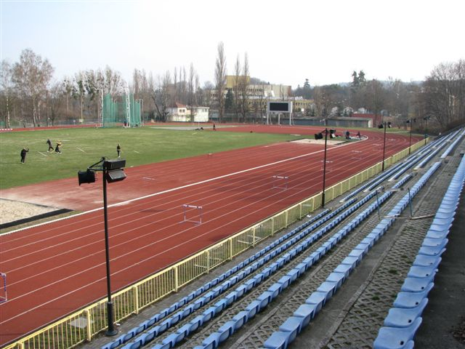
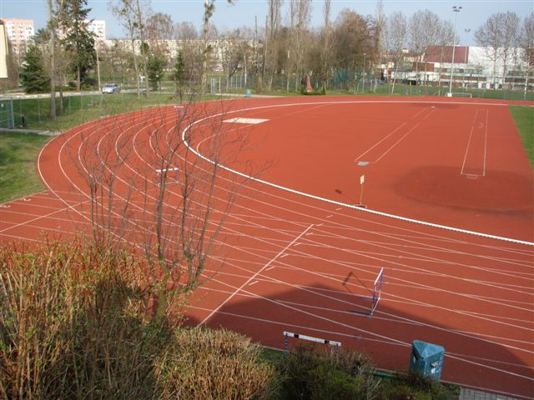
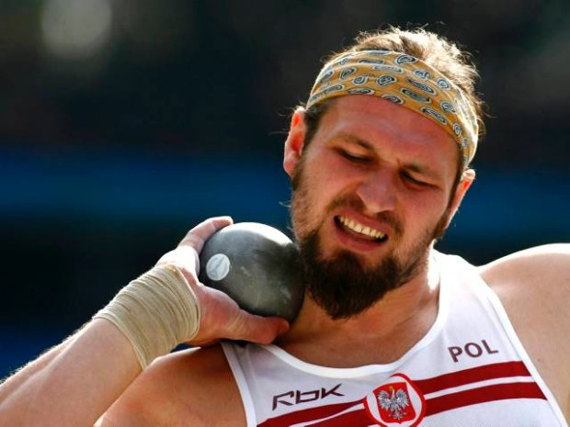
Sport facilities –the Academy of Pfysical Education

Slide 15
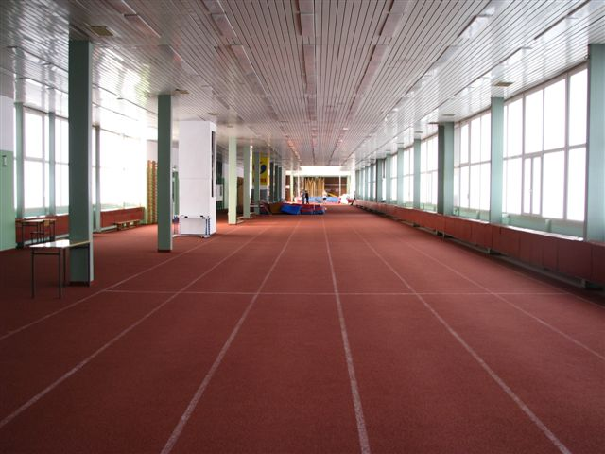
The sport hall for athletics – the Academy of PE

Slide 16
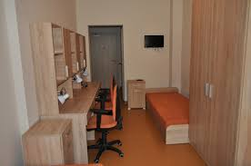
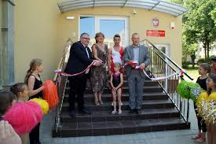
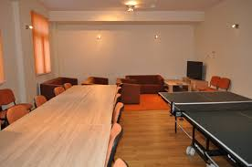
BOARDING SCHOOL

Slide 17
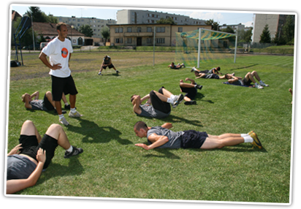
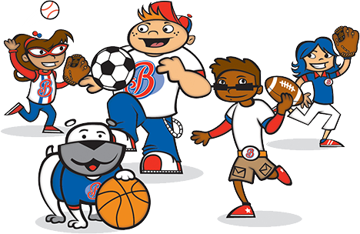
PRIMARY SCHOOL
General training
All activity. Running, jumping, throwing,
Play soccer, basketball,
Handball, volleyball etc.
10 h per week

Slide 18
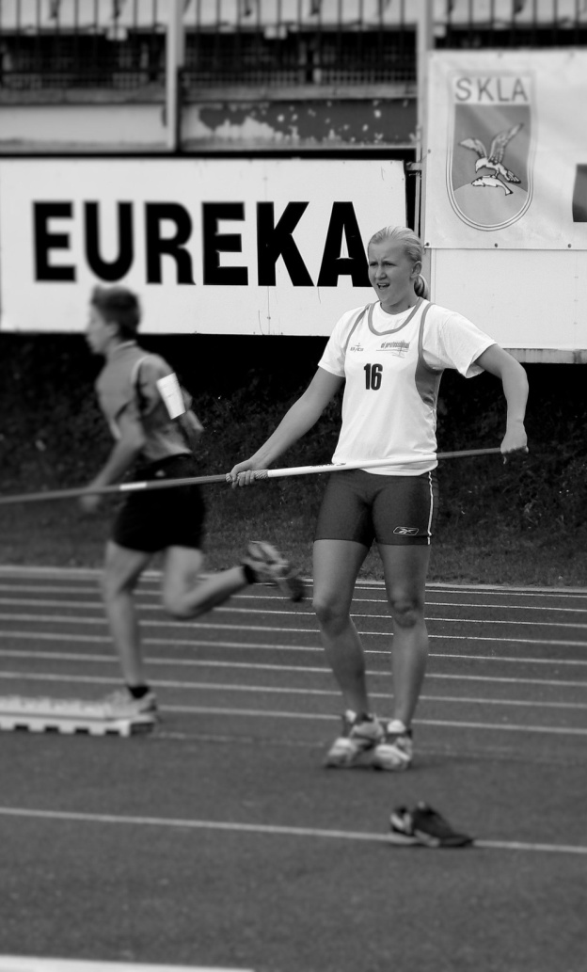
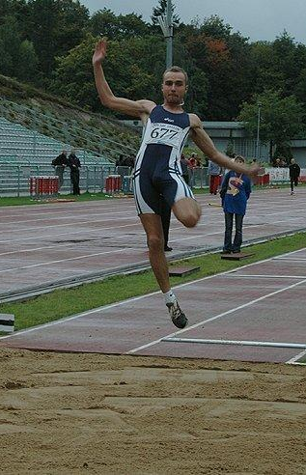
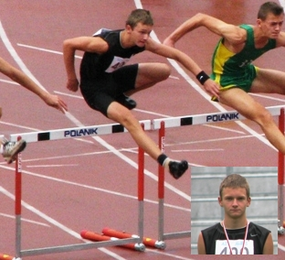
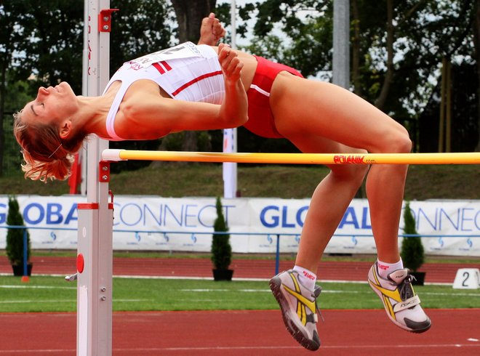
GYMNASIUM
Direction training
Discus throw, javelin throw,
Hammer throw, shot put
Or
Long jump, high jump, pole vault
Or
Sprint
(100, 300, 100/110/300 hurdles Or
Long distans (600, 1000)
12 hours

Slide 19
SECONDARY SCHOOL
Specialized training
Discus, javelin,
Hammer throw, shot put
Or
Long, high jump, pole vault
Or
Sprint
(100, 200, 400, 100/110/400 hurdles) Or
Long distans (800,1500 ect.) and walk
19 hours

Slide 20
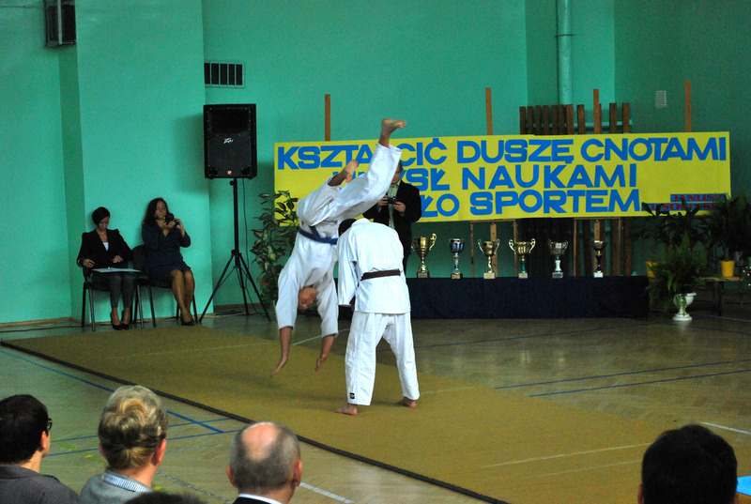
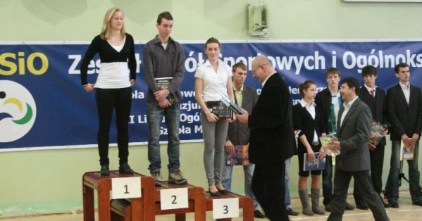
Summing up sport achivements

Slide 21
European projects
2009-2011 COMENIUS „European Studies School Network”
2012-2014 COMENIUS „Young European Enterpreneurs of the Future”
2015-2016 ERASMUS+ for teachers KA 1 „Teach in a modern, interestning and effective way”
2017-2018 ERASMUS+ for teachers KA 1 „We count on the development”
2018-2020 ERASMUS+ KA 2 : „Effective education, better future”

Slide 22
European projects
2014 – Polish – Russian exchange: „Polish and Russian environment – how to protect it”
2015 – Polish – Russian exchange: „70 th anniversary II WW finish and its place in Polish and Russian memory”
2017 – Polish – Russian exchange: „How modern technology can change young people’s lives”

