Slide 1
From Diversity to Employability
Stockholm meeting
10-13 Feb 2019

Slide 2
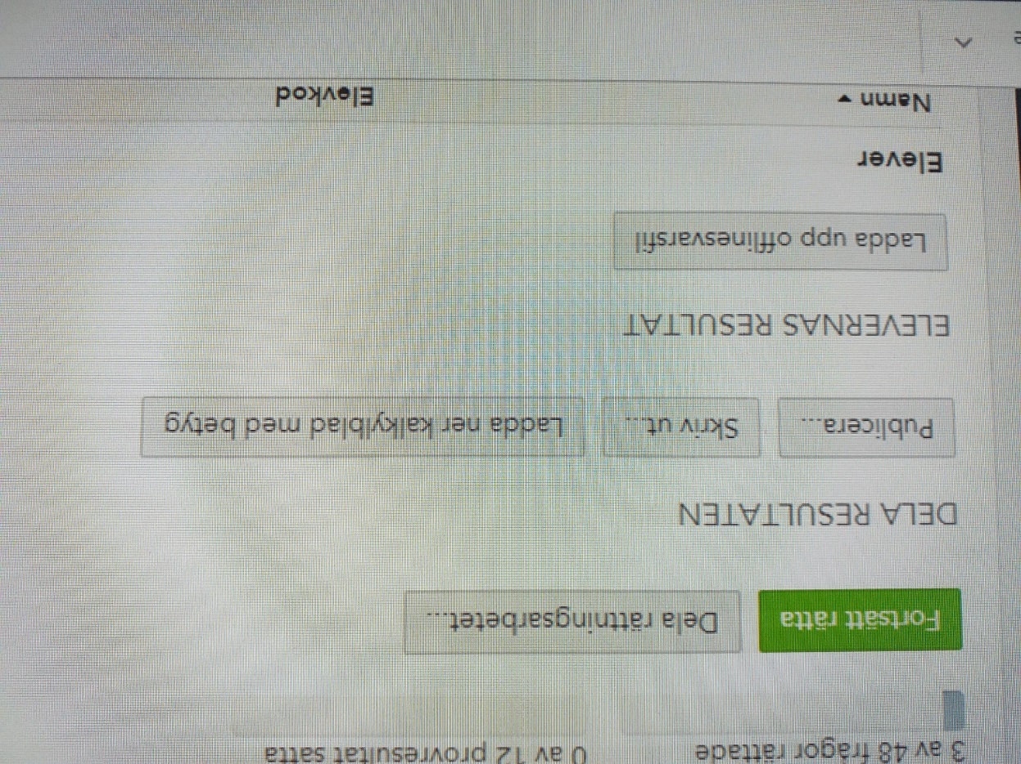
Presentation Digiexam
An administrativ tool for making digital tests

Slide 3
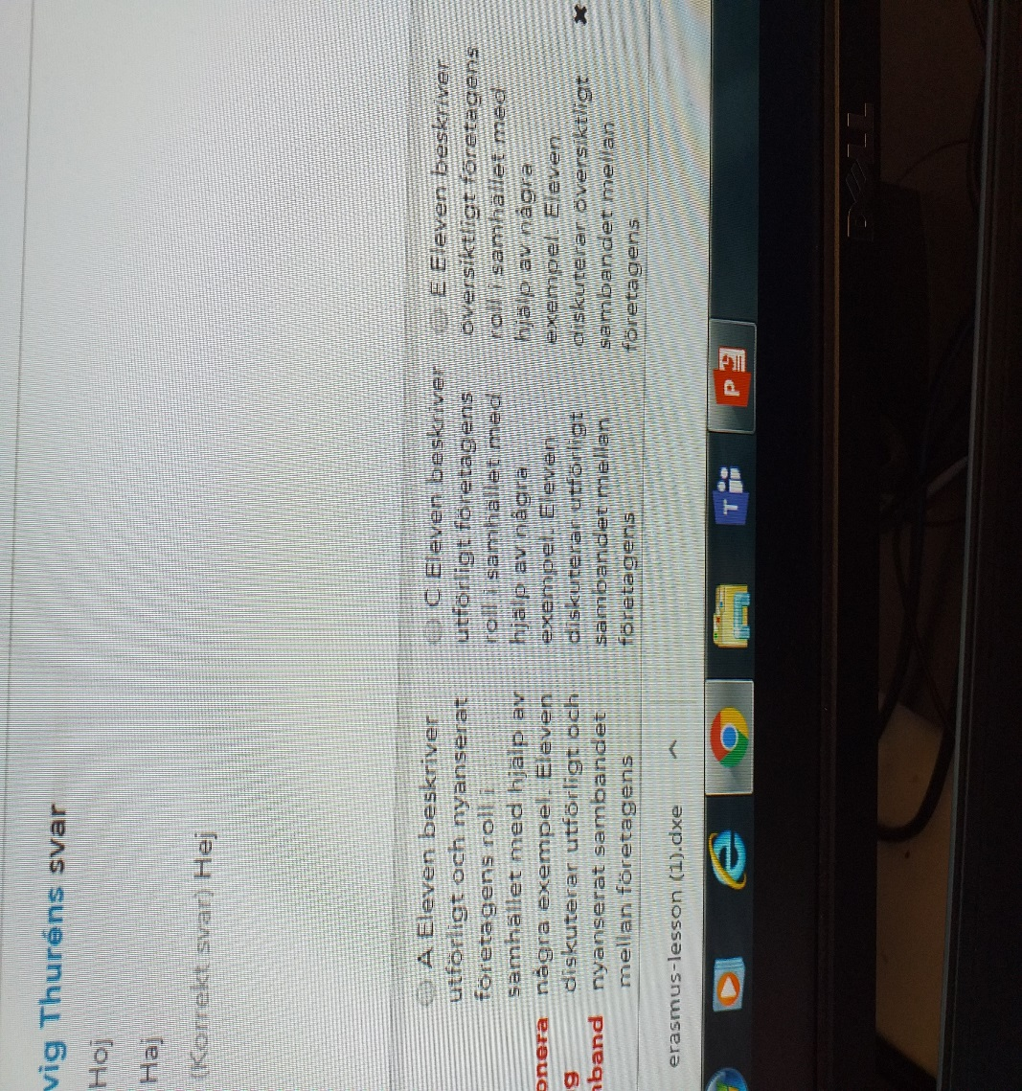
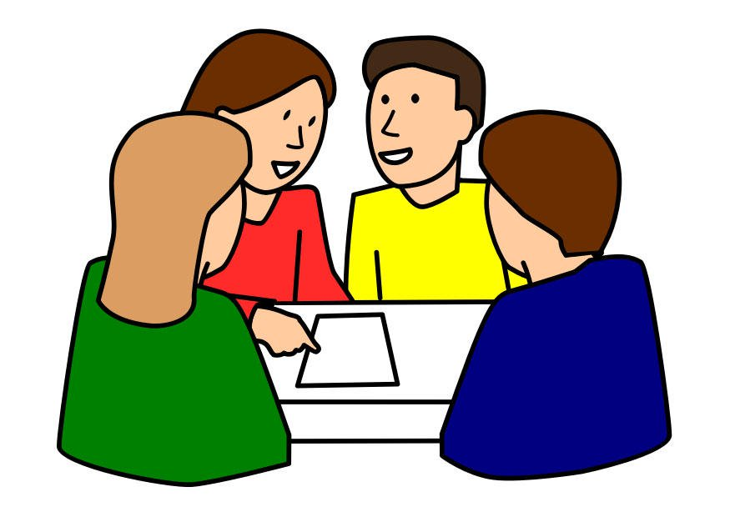
Digiexam Workshop

Slide 4

Workshop
One teacher and two swedish students join with one computer
Students log in
Start the test
(I can monitor you easily throug my computer)
Send in when finished

Slide 5
Outcome
Students likes it….
It makes it easier to write and disponate your text digitally. You get feedback faster digitally frpm the teacher.
Teachers likes it….
It is easier to correct and leave feedback. You can share corrections with a collegues. You only carry a computer and not loads of paper when ou correct tests. You have student results saved digitally.

Slide 6
What to try out? Your task until Helsinki meeting:
Find out what digital systems you have at your school that will help you as a teacher for example to correct tests or to give feedback digitally.
How does it work?
What do teachers and pulis/students think about it?

