Slide 1
From Diversity to Employability
Stockholm meeting
10-13 Feb 2019

Slide 2
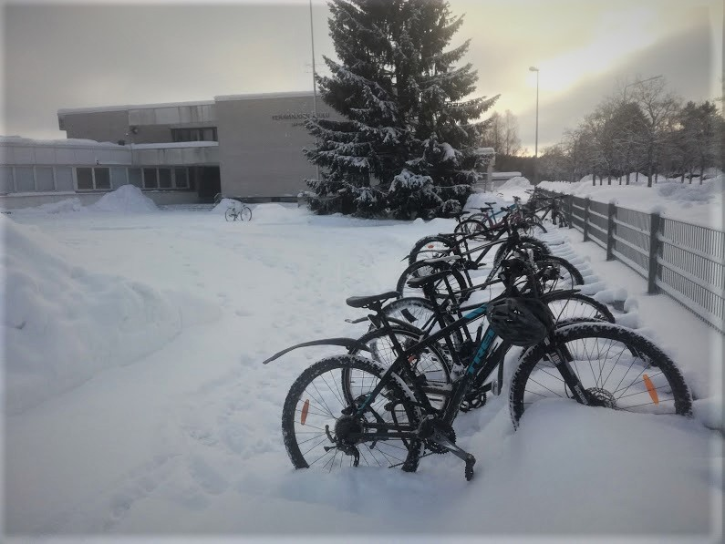
Keravanjoki school

Slide 3
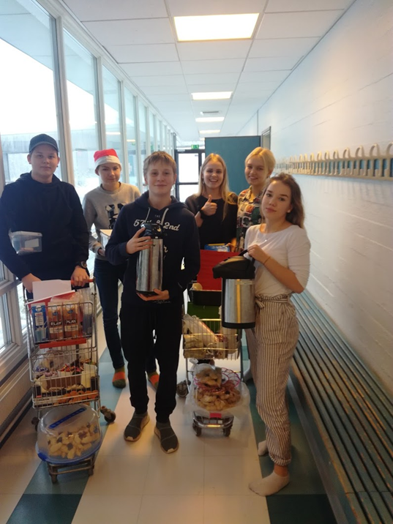
Work practice
There is a work practice program in Finland’s schools. The students of Keravanjoki school have practical training
1 day in 7th class
1 week in 8th class
2 weeks in 9th class
Furthermore, we earn some pocket money and do some charity work. Before we’ve had some canteen in our school e.g. on election day, we’ve run some discos for primary school pupils and gave e.g. Lucia presentations in elderly homes.
After Mantova meeting we needed to create some new tasks.
We decided to start a pop-up cafe in our school and expand our charity work.

Slide 4
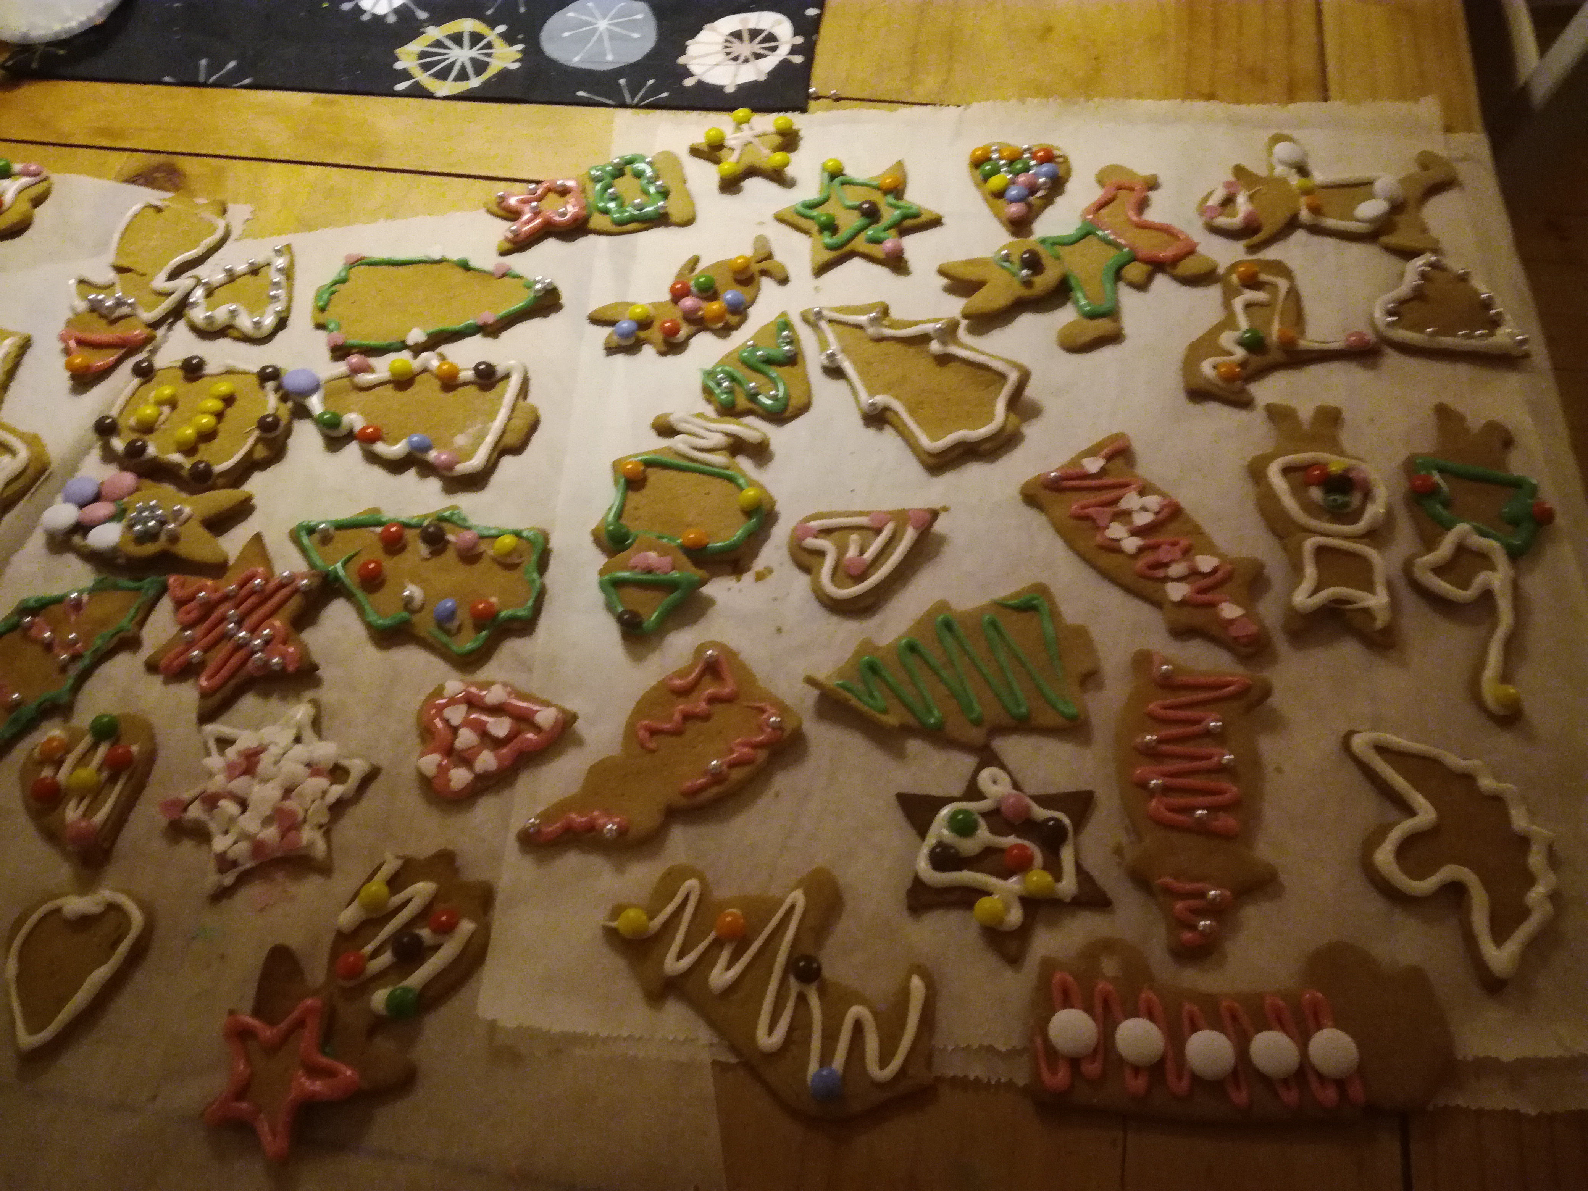
What did we do?
We set up a pop-up cafe with Christmas edition. We planned a timetable, we organized, advertised, baked and sold delicacies.
We went to nursing homes. We were singing, playing ukuleles, reciting poems and serving lunch, dessert and coffee to the seniors. We were also chatting with the senior citizens.

Slide 5
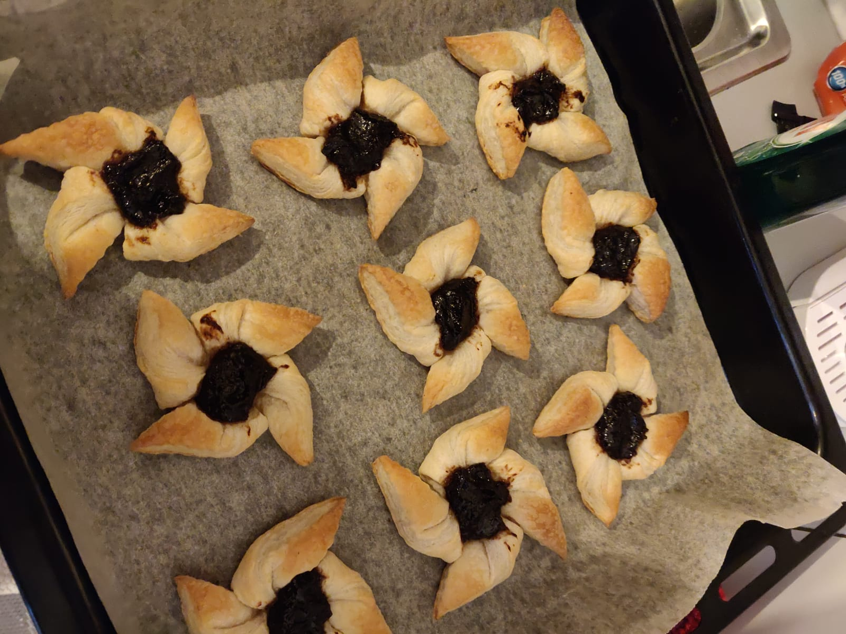
What did we learn?
We learned team working. We learned to communicate easily and make a polite conversation with the seniors. We found the joy of doing something good for other people: we learned that charity work and performing are really rewarding.
We liked everything. We liked selling and serving in pop-up café and singing, serving and chatting with the seniors in nursing homes. We liked that the residents were really happy about our performance. It was really fun: making people happy made us so happy too.
The whole thing went well: We worked together as a team. We sold almost everything we had in café. In nursing homes we managed to put together awesome shows, the visits were successful. Everyone was really pleased about our visits.
The challenges were quite small: Sometimes it was little hard to find the change in the café. In elderly homes it was not that easy to talk to the residents at first. We also had some misunderstandings about our program. But finally everything went well.
We liked everything. There was nothing that we didn’t like.

Slide 6
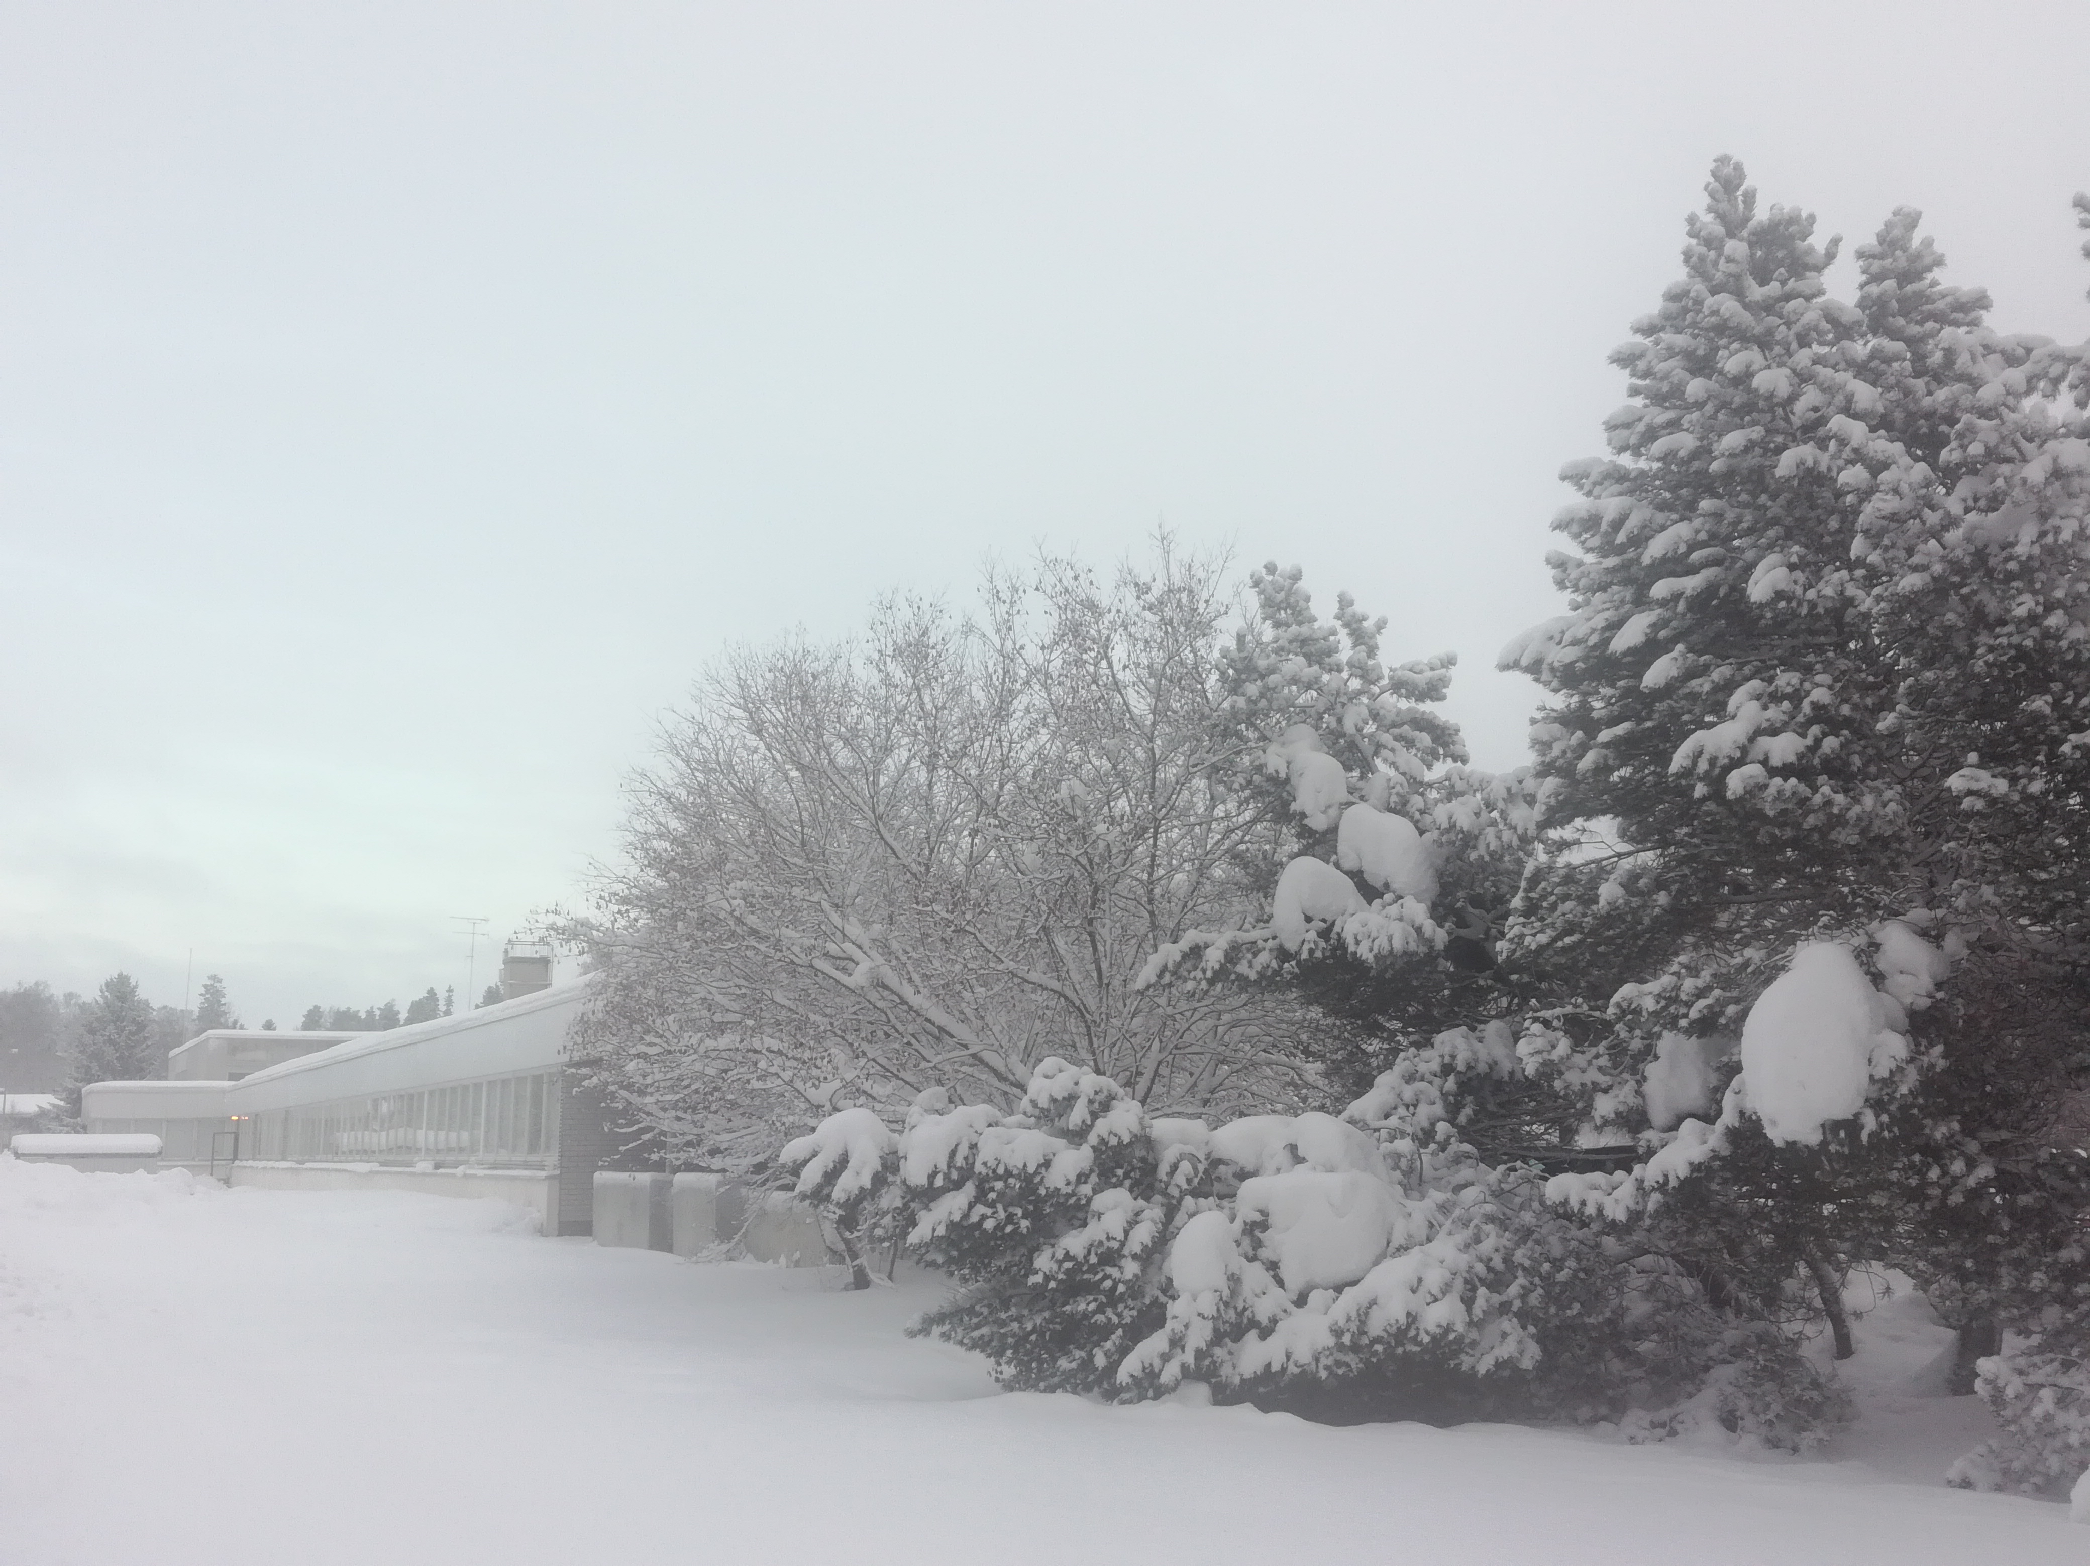

What would we do differently next time?
Some of us would do nothing differently next time, because everything went very well. Some of us would like to spend more time in nursing homes (maybe a school day), practice more for the performances and be more social and talk more with the seniors.
We are now planning to build a pop up cafe with Valentine’s edition. We are practicing the new performance with ukulele band and poetry group for seniors, carrying out in March. We would also like to continue giving our help in lunch serving for old people.

